Slide 1
Applying Primitive Elements Theory for Procedural Transfer in Soar
Bryan Stearns
37th Soar Workshop
June 8, 2017

Slide 2


Modeling Cognition: Transfer
Modeling human procedural transfer
Gold standard for task-general procedural transfer
Transfer: Practicing task A leads to faster learning of a different task B.
Cognitive architectures: Theories of cognition
How well do different theories model transfer?

Slide 3
Architecture Comparison
Primitive Elements Theory (Taatgen, 2013):
State-of-the-art task-general human transfer model
Based in ACT-R (an extension called Actransfer)
Could be applied to Soar
Using different architectural mechanisms
Soar version: The PROP model
Same results? Better modeling?
My work: Architecture comparison
ACT-R theory
Soar theory
Apply both to same learning task

Slide 4

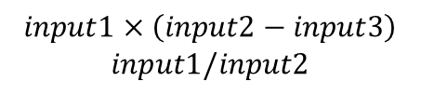
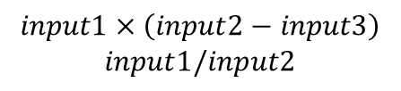
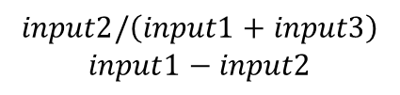
The Elio (1986) task
Simple human transfer experiment
Mental algebra task
Does practicing some calculations improve speed on others?
Trained on one set of calculations,
Tested on either:
Control Test: new calculations
Transfer Test: shared calculations
Training
Control Test
Transfer Test
$$input1×\left(input2−input3\right)$$
$$input1/input2$$
$$input2/\left(input1+input3\right)$$
$$input1−input2$$
$$input1×\left(input2−input3\right)$$
$$input1/input2$$

Slide 5
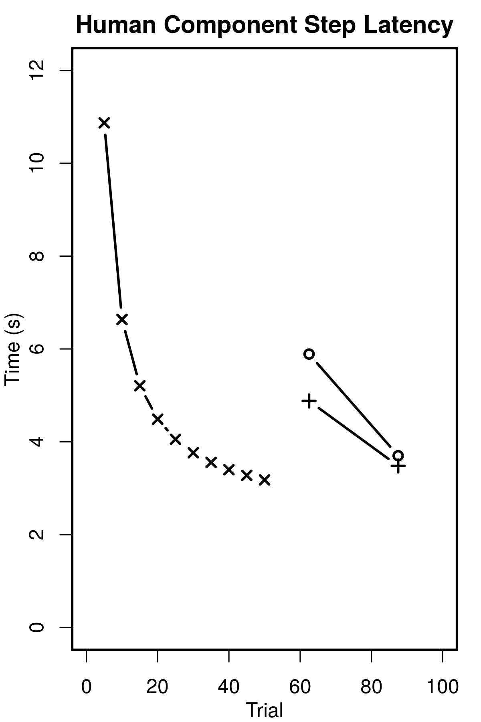
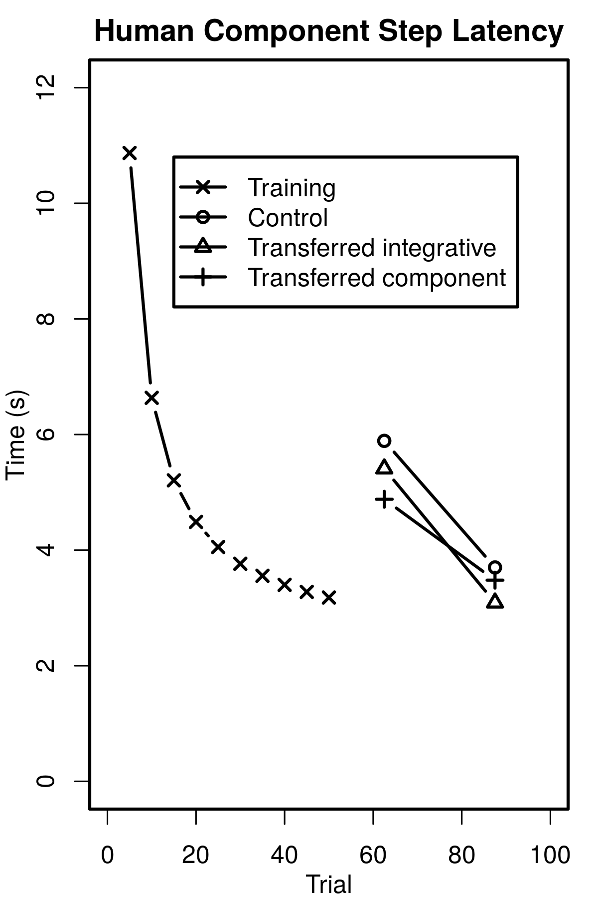


Elio Human Results
Power-law of learning
Significant transfer
Even in the control
How would an architecture model such transfer?
Using task-general methods
(Can’t assume algebra domain)
Primitive Elements Theory describes one approach
Training
Control test
Transfer test
Training
Test
(averages)

Slide 6
ACT-R: Identical Productions Theory
(Singley & Anderson, 1987)
Models transfer by sharing rules between tasks.
No transfer if no common rules
Training
Control Test
Transfer Test
$$input1×\left(input2−input3\right)$$
$$input1/input2$$
$$input2/\left(input1+input3\right)$$
$$input1−input2$$
$$input1×\left(input2−input3\right)$$
$$input1/input2$$
ExampleRule1 {
IF (task is “input2 min input3”)
IF (arg1 is nil)
THEN
(action_type = “retrieve“)
(action_arg = “input2”)
}
Retrieve the value of “input2” for use in calculation.

Slide 7
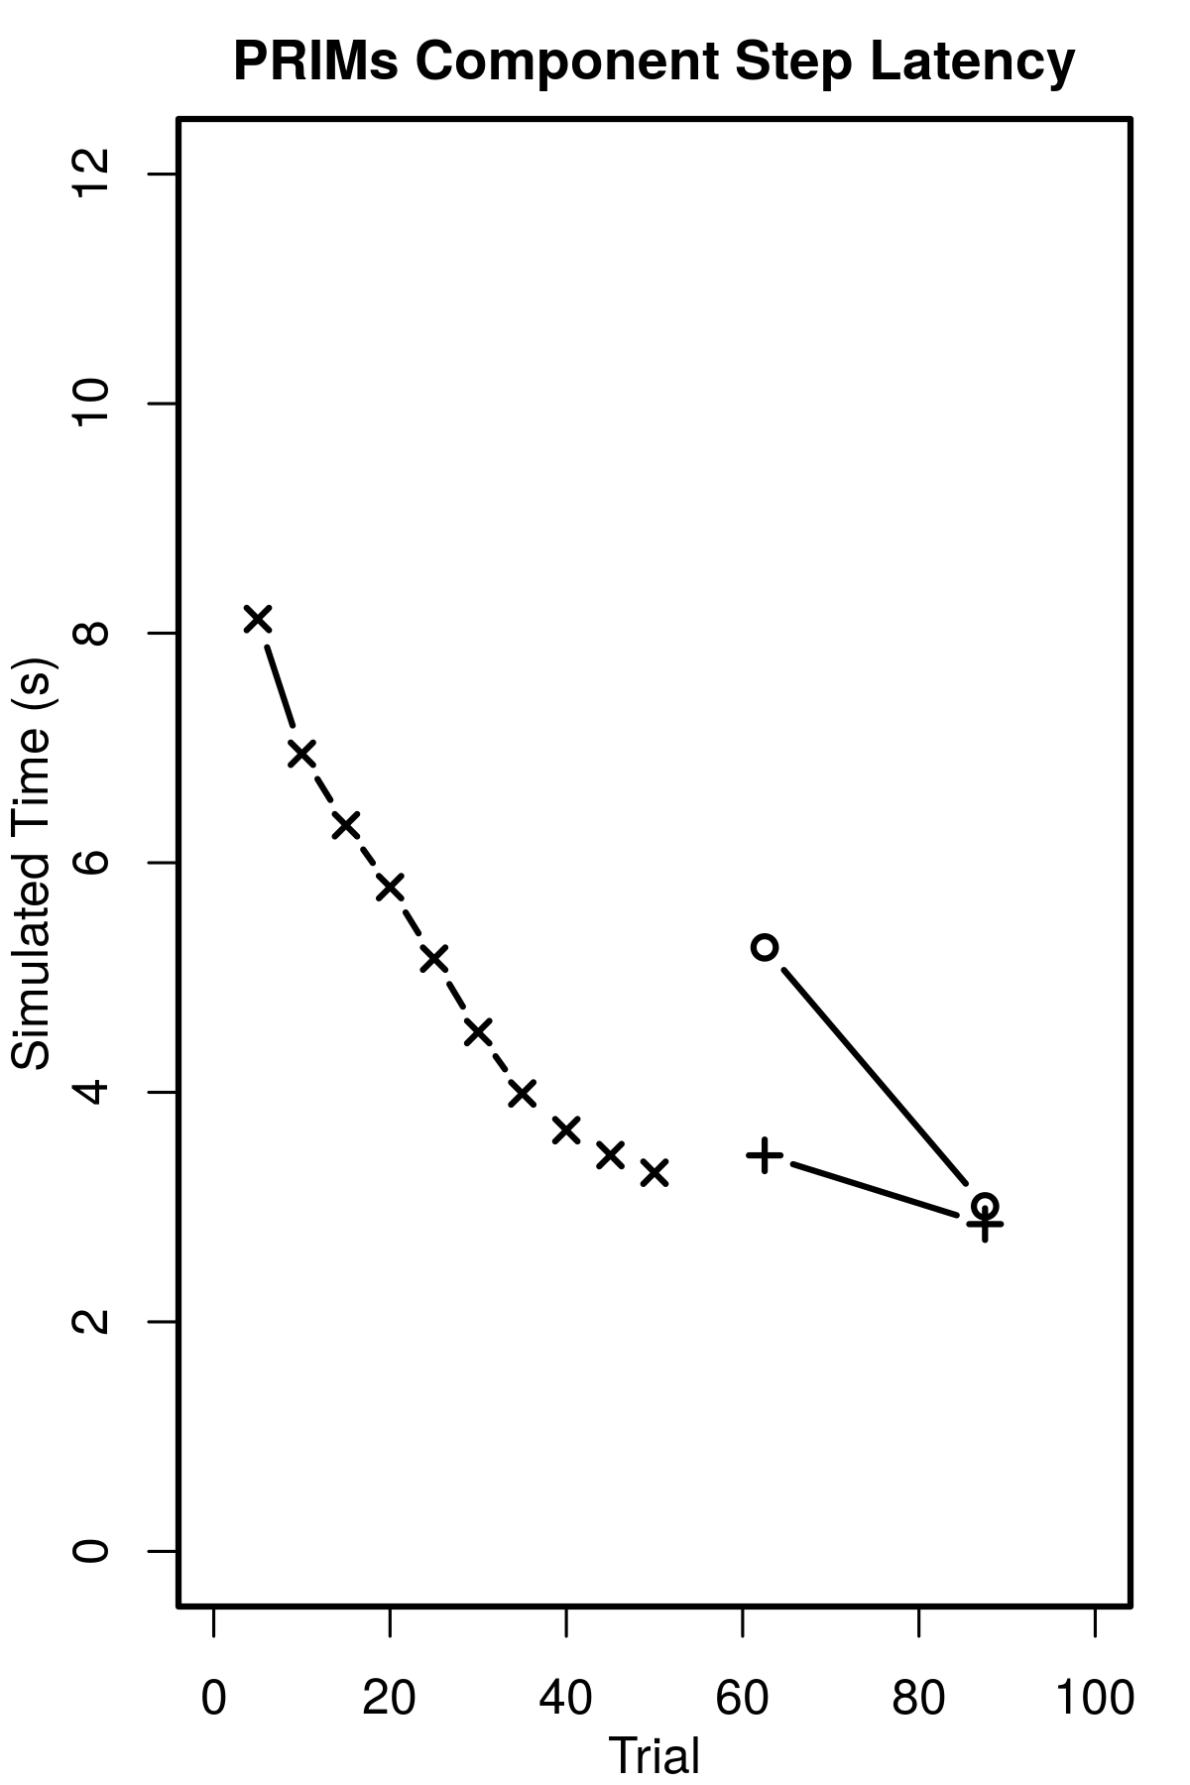
ACT-R: Learning
Models learning by combining sequenced rule firings
Gradually fewer decision cycles
Part1 {
IF (task is “input2 min input3”)
THEN
(action_type = “retrieve“)
}
Part2 {
IF (arg1 is nil)
THEN
(action_arg = “input2”)
}
+
Initial rules
ExampleRule1 {
IF (task is “input2 min input3”)
IF (arg1 is nil)
THEN
(action_type = “retrieve“)
(action_arg = “input2”)
}
=
Composed rules

Slide 8
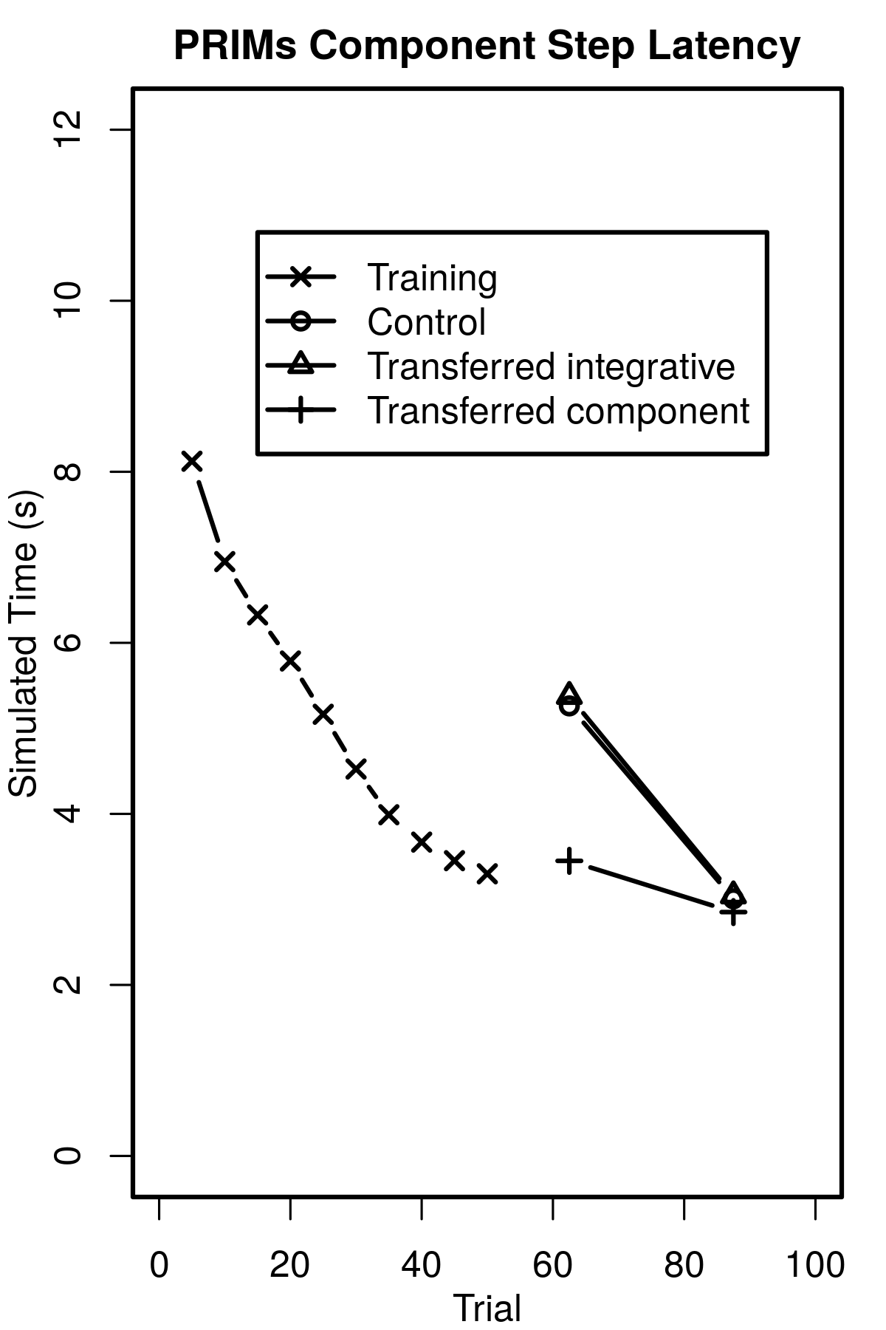
ACT-R: Learning
Models learning by combining sequenced rule firings
Gradually fewer decision cycles
Compositions transfer if reused.
Primitive Elements Theory extends this idea to the lowest architectural level…

Slide 9
Actransfer: Primitive Elements Theory
Compose architecturally primitive rules (PRIMs) into all other rules.
“Assembly level” rule operations:
Load values into memory slots
Compare values between A and B
Requires declarative instructions
Identical Productions
(Singley & Anderson, 1987)
Primitive Elements
(Taatgen, 2013)
slot1 = “input2 min input3”
slot2 = “retrieve”
slot3 = “lime4”
5 PRIMs
(5 steps):
ExampleRule1 {
IF (task is “input2 min input3”)
IF (arg1 is nil)
THEN
(action_type = “retrieve“)
(action_arg = “input2”)
}
IF (task == slot1)
Compose
IF (arg1 is nil)
(action_type = slot2)
(action_arg1 = slot3)
(1 step)

Slide 10
Actransfer: Primitive Elements Theory
Models transfer by sharing compositions of PRIMs.
Regardless of operation values.
Identical Productions
(Singley & Anderson, 1987)
Primitive Elements
(Taatgen, 2013)
slot1 = “index1 plus index2”
slot2 = “retrieve”
slot3 = “index1”
slot1 = “lime4 min lime2”
slot2 = “retrieve”
slot3 = “lime4”
slot1 = “lime4 min lime2”
slot2 = “retrieve”
slot3 = “lime4”
slot1 = “index1 plus index2”
slot2 = “retrieve”
slot3 = “index1”
ExampleRule1 {
IF (task is “lime4 min lime2”)
IF (item1 is nil)
THEN
(action_type = “retrieve“)
(action_arg = “lime4”)
}
ExampleRule1 {
IF (task is “index1 plus index2”)
IF (item1 is nil)
THEN
(action_type = “retrieve“)
(action_arg = “index1”)
}
Composition
already practiced!
IF (task == slot1)
IF (task == slot1)
IF (item1 is nil)
IF (item1 is nil)
(action_type = slot2)
(action_type = slot2)
(action_arg1 = slot3)
(action_arg1 = slot3)

Slide 11
Actransfer: Primitive Elements Theory
Models Elio Control Task
Still imperfect:
Flat learning curve
Extra transfer for Transfer Task (from shared calculation rules)
Identical Productions
(Singley & Anderson, 1987)
Primitive Elements
(Taatgen, 2013)
Human
PRIMs
Training
Control
Transfer

Slide 12
Applying Primitive Elements to Soar
Soar has primitive rule operations:
Conditions: equals, not-equals, greater-than…
Actions: create, remove, propose, …
However…
Assembly-style PRIMs assume register-style memory references
Given by the architecture...

Slide 13
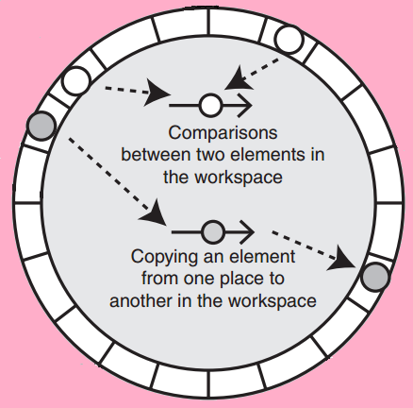
PRIMs are initial knowledge
Primitives: operate on specific working memory elements.
(A = B) is different from (B = C)
PRIM rules correspond to all memory operations.
380 ways of copying among 20 memory elements:
380 initial PRIM copy rules
Requires a fixed set of working memory elements
Procedural Memory
Actransfer Workspace
Figure from (Taatgen, 2013)

Slide 14
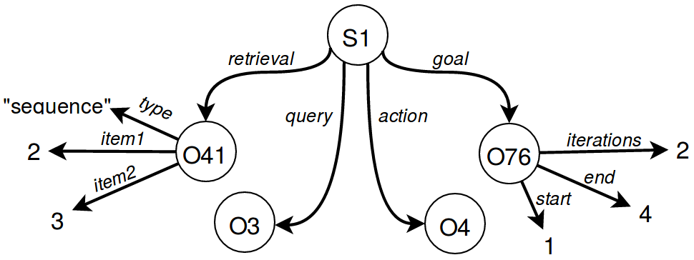
Soar’s variable memory access
Working memory is a dynamic semantic graph.
Any shape/size, changes over time.
Edges point to elements (WMEs).
Unbounded possible edge paths.
Infinite possible graph element operations
Copy
newitem
Copy
2

Slide 15
Soar: Primitive Operators (PROPs)
PRIMs are primitive rules
PROPs are primitive operators!
PROPs through rules use variables.
New subgoal layer:
Bind variable references
Using declarative knowledge
Identical Productions
(Singley & Anderson, 1986)
Primitive Elements
(Taatgen, 2013)
Primitive Referencing
IF (<var1> == <var2>)
IF (S1.task == S1.slot1)
IF –(<var3>)
IF –(S1.item1)
(<var4> = <var5>)
(S1.action_type = S1.slot2)
(<var6> = <var7>)
(S1.action_arg1 = S1.slot3)

Slide 16
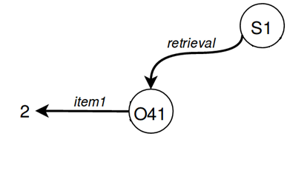
The WME reference operator
PROP: Superstate operator
Copy (<m2> = <m1>)
Reference binding: Substate operator
Given reference string “S1.retrieval.item1”
Step through memory to the desired WME.
Result can be chunked.
“S1.retrieval.item1”
S1
(<m2> = <m1>)
(<m2> = S1.retrieval.item1)

Slide 17
Layers of learning
ExampleRule1 {
IF (task is “lime4 min lime2”)
IF (item1 is nil)
THEN
(action_type = “retrieve“)
(action_arg = “lime4”)
}
Layer 3:
Task-specific productions
Layer 2:
Transferrable compositions
Layer 1:
Composable operations on specific WMEs
Identical Productions
(Singley & Anderson, 1987)
L3 Chunking
IF (S1.task == S1.slot1)
IF –(S1.item1)
(S1.action_type = S1.slot2)
(S1.action_arg1 = S1.slot3)
Primitive Elements
(Taatgen, 2013)
L2 Chunking
IF (S1.task == S1.slot1)
IF –(S1.item1)
(S1.action_type = S1.slot2)
(S1.action_arg1 = S1.slot3)
Primitive Referencing
L1 Chunking
IF (<var1> == <var2>)
IF –(<var3>)
(<var4> = <var5>)
(<var6> = <var7>)

Slide 18
Evaluation
A 3-way comparison of learning levels:
Human
PRIM model: Layers 2,3
PROP model: Layers 1,2,3 (can turn on/off)
Soar/Actransfer agents learn same rules.
PROPs simulates gradual chunking via agent decision making.
A preview of possible gradual chunking in Soar
Overheads not included in results
Results in simulated time: 50 ms / decision cycle

Slide 19
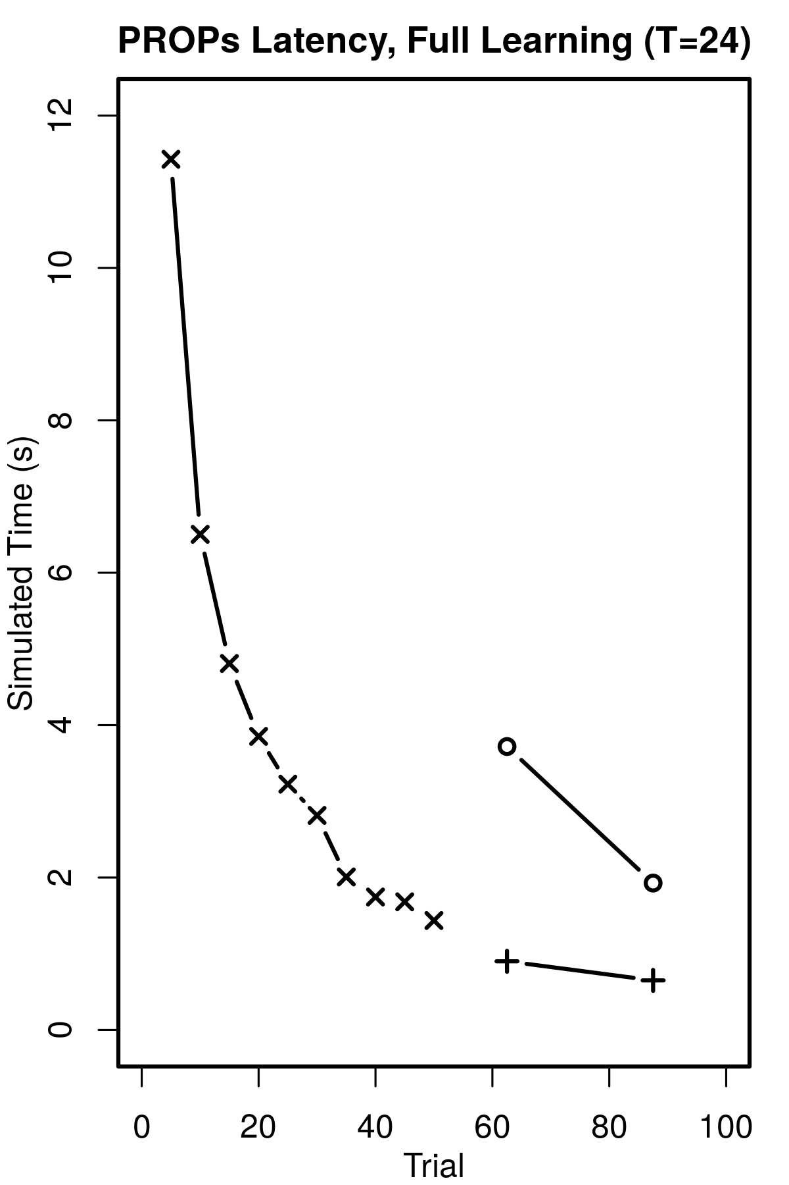
Results: Layer 1 Learning
Layer 1 PROP chunking:
More initial effort.
Provides human-like power-law learning.
PROPs
Human
L1,2,3
Training
Control
Transfer

Slide 20
Results: Layer 3 Learning
Layer 3 full-rule chunking:
Converges to optimal behavior
Unlike human performance
PROPs
Human
L1,2,3
Training
Control
Transfer

Slide 21
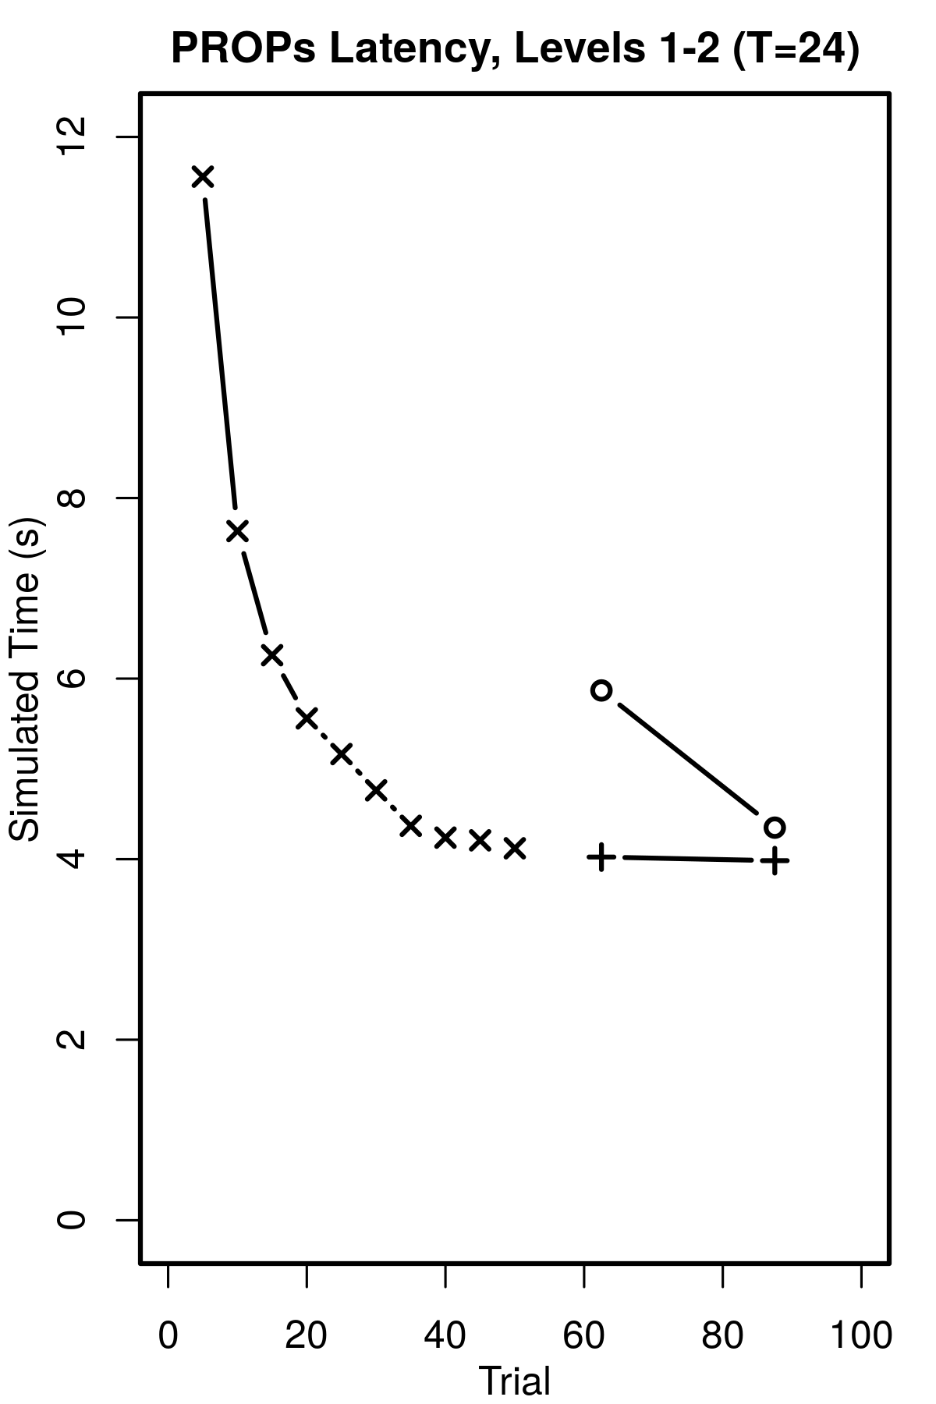
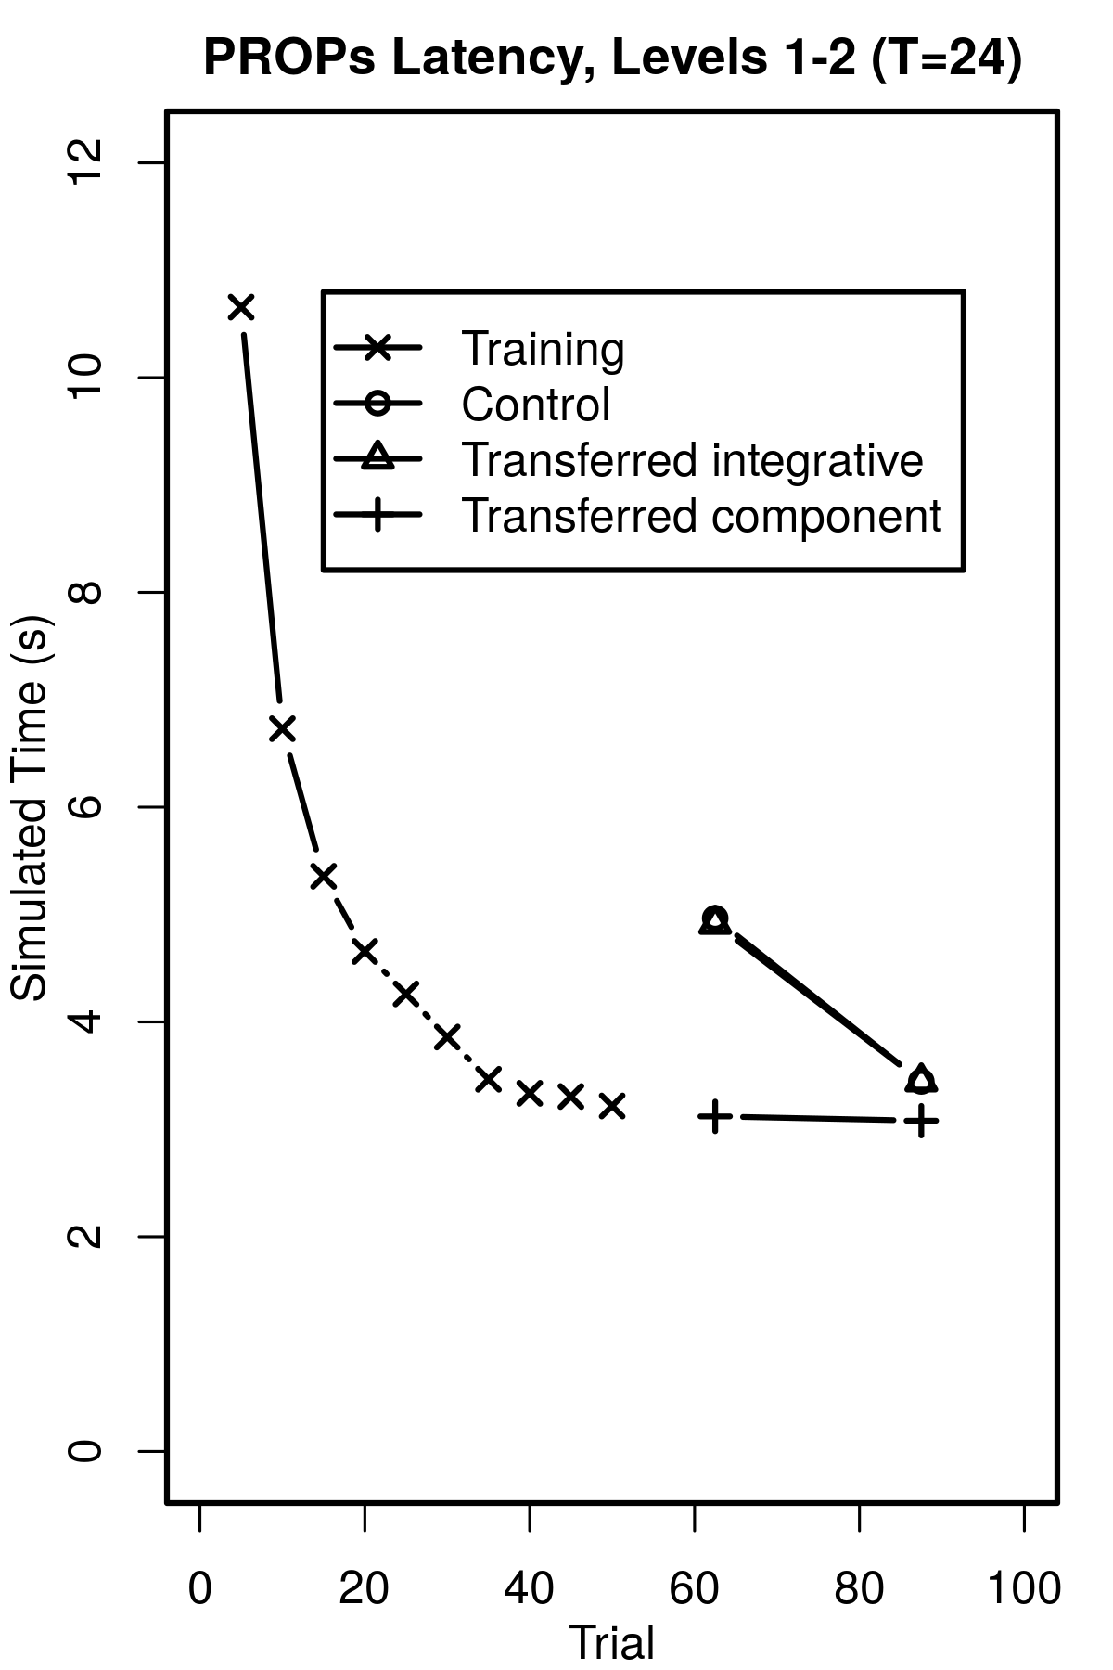
PROPs with Layers 1-2
Disabling Layer 3 learning in PROPs results in a close human learning model.
Learning time scale is only off by a constant.
L1,2
L1,2-shift
Human
Shift time by a constant

Slide 22
Results: Transfer
Similar to Actransfer
Control Test: Transferring primitives
Transfer Test: Extra from Identical Productions.
Both agents learned the same productions.
PRIMs
Human
PROPs
Training
Control
Transfer

Slide 23
Summary of results
Similar transfer for both PRIMs and PROPs
Human-like learning curve from PROPs
PRIMs
Human
PROPs
Training
Control
Transfer
Notes:
PROPs has lower transfer averages arguably because of power law shape

Slide 24

PROPs: Nuggets and Coal
Nuggets:
Task-general transfer of rule compositions.
Unbounded learning of Soar’s memory graph.
Closely models human power-law learning.
Coal
Too much transfer from shared task productions for human modeling.
Gradual chunking is not defined in current Soar.

Slide 25
Future work
Development of gradual confidence-based chunking in Soar
Automatic transferrable rule learning under uncertainty.
Integrating architecturally primitive learning in a practical domain.
Rosie & verbal instructor interaction (Kirk & Laird, 2016; Mininger & Laird, 2016)

Slide 26
Bibliography
Anderson, J. R. (2009). How Can the Human Mind Occur in the Physical Universe? Oxford University Press.
Elio, R. (1986). Representation of similar well-learned cognitive procedures. Cognitive Science, 10(1), 41 - 73.
Kirk, J. R., & Laird, J. E. (2016). Learning General and Efficient Representations of Novel Games Through Interactive Instruction. Advances in Cognitive Systems, 4.
Laird, J. E. (2012). The Soar Cognitive Architecture. The MIT Press.
Mininger, A., & Laird, J. E. (2016). Interactively Learning Strategies for Handling References to Unseen or Unknown Objects. Advances in Cognitive Systems, 4.
Singley, M. K. & Anderson, J. R. (1987). A Keystroke Analysis of Learning and Transfer in Text Editing. Hum.-Comput. Interact., 3(3), 223–274.
Taatgen, N. A. (2013). The Nature and Transfer of Cognitive Skills. Psychological Review.
Thorndike, E. L. (1922). The Effect of Changed Data upon Reasoning. Journal of Experimental Psychology, 5(1), 33.

Slide 27
Questions?

Slide 28
Why human transfer modeling?
Modeling is a tool for understanding how humans do it.
Once we understand, we can apply the principles as needed.
“The primary remaining issue for the realization of human-level AI is the realization of general intelligence capable of solving flexible problems by combining highly reusable knowledge.” “Whole brain architecture approach is a feasible way toward an artificial general intelligence.” (Yamakawa et al., 2016)
General Intelligence: “The same scope of intelligence as we see in human action: that, in any real situation, behavior appropriate to the ends of the system and adaptive to the demands of the environment can occur.” (Newell, 1976)
“There is no more important topic in the whole psychology of learning than transfer of learning… Practically all training programs are built upon the fundamental premise that human beings have the ability to transfer what they have learned from one situation to another.” (Desse, 1958, p.213)

Slide 29
Declarative vs Procedural Knowledge
Declarative memory
Also called explicit memory
Consciously recalled or declared
“Knowing what”
Procedural memory
Also called implicit memory
Unconscious or automatic skills
“Knowing how”
(Schacter, 1987)

Slide 30
Example
Learned Skills
1:
LOAD INSTRUCTIONS:
const1 = “index1 plus index2”
const2 = “retrieve”
const3 = “index1”
1:
ExampleRule1 {
IF (task is “index1 plus index2”)
IF (item1 is nil)
THEN
(action_type = “retrieve“)
(action_arg1 = “index1”)
}
2:
IF (task == const1)
IF (item1 is nil)
THEN
(action_type = const2)
(action_arg1 = const3)
Practice
IF (task == const1)
IF (item1 is nil)
(action_type = const2)
(action_arg1 = const3)
Practice
IF (task == const1)
IF (item1 is nil)
THEN
(action_type = const2)
(action_arg1 = const3)
1:
LOAD INSTRUCTIONS:
const1 = “index1 plus index2”
const2 = “retrieve”
const3 = “index1”
1:
LOAD INSTRUCTIONS:
const1 = “index1 plus index2”
const2 = “retrieve”
const3 = “index1”
Practice
2:
IF (task == const1)
2:
IF (task == const1)
IF (item1 is nil)
ExampleRule1 {
IF (task is “index1 plus index2”)
IF (item1 is nil)
THEN
(action_type = “retrieve“)
(action_arg1 = “index1”)
}
3:
IF (item1 is nil)
4:
(action_type = const2)
3:
(action_type = const2)
(action_arg1 = const3)
5:
(action_arg1 = const3)

Slide 31
Transferring Level 2 knowledge
Learned Skills
1:
ExampleRule2 {
IF (task is “lime4 minus lime2”)
IF (item1 is nil)
THEN
(action_type = “read“)
(action_arg1 = “lime4”)
}
Task:
“lime₄ – lime₂”
IF (task == const1)
IF (item1 is nil)
(action_type = const2)
(action_arg1 = const3)
Practice
1:
LOAD INSTRUCTIONS:
const1 = “lime4 minus lime2”
const2 = “read”
const3 = “lime4”
IF (task == const1)
IF (item1 is nil)
THEN
(action_type = const2)
(action_arg1 = const3)
2:
IF (task == const1)
IF (item1 is nil)
THEN
(action_type = const2)
(action_arg1 = const3)
IF (task == const1)
3:
IF (item1 is nil)
4:
(action_type = const2)
ExampleRule1 {
IF (task is “index1 plus index2”)
IF (item1 is nil)
THEN
(action_type = “retrieve“)
(action_arg1 = “index1”)
}
5:
(action_arg1 = const3)

Slide 32
Gradual rule learning for transfer
Gradual learning lets experience determine which compositions are useful for transfer.
A composition choice is not easily undone
Soar does not define gradual chunking.
Chunking under uncertainty
A
B
C
A
B
X
B
C
B
C
Transfer
VS
No Transfer
C
D
D

Slide 33
PRIMs: 3 layers of skill knowledge
Level 1: Primitive memory operations
“Innate”: initially given
Are used in all skills.
But they are slow to perform individually.
Level 2: Task-general compositions of primitives
Faster, but still general.
Can be used for transfer
Level 3: Task-specific rules
Are fast.
But they are not general.
1:
LOAD INSTRUCTIONS:
const1 = “index1 plus index2”
const2 = “retrieve”
const3 = “index1”
1:
LOAD INSTRUCTIONS:
const1 = “index1 plus index2”
const2 = “retrieve”
const3 = “index1”
1:
ExampleRule1 {
IF (task is “index1 plus index2”)
IF (item1 is nil)
THEN
(action_type = “retrieve“)
(action_arg1 = “index1”)
}
2:
IF (task == const1)
3:
IF (item1 is nil)
2:
IF (task == const1)
IF (item1 is nil)
4:
(action_type = const2)
3:
5:
(action_type = const2)
(action_arg1 = const3)
(action_arg1 = const3)
Level 1
Level 2
Level 3

Slide 34
Compiling Layer 2 knowledge
1:
ExampleRule2 {
IF (task is “index1 plus index2”)
IF (item1 is not nil)
IF (item2 is not nil)
THEN
(action_type = “retrieve“)
(action_arg1 = “sum”)
(action_arg2 = item1)
(action_arg3 = item2)
}
Learning L3
1:
LOAD INSTRUCTIONS:
const1 = “index1 plus index2”
const2 = “retrieve”
const3 = “sum”
Retrieve the sum of the addends:
(sum, 1, 2) = 3
Practice
2:
IF (task == const1)
IF (item1 is not nil)
IF (item2 is not nil)
THEN
(action_type = const2)
(action_arg1 = const3)
(action_arg2 = item1)
(action_arg3 = item2)
Practice
1:
LOAD INSTRUCTIONS:
const1 = “index1 plus index2”
const2 = “retrieve”
const3 = “sum”
1:
LOAD INSTRUCTIONS:
const1 = “index1 plus index2”
const2 = “retrieve”
const3 = “sum”
1:
LOAD INSTRUCTIONS:
const1 = “index1 plus index2”
const2 = “retrieve”
const3 = “sum”
2:
IF (task == const1)
IF (task == const1)
IF (item1 is not nil)
IF (item2 is not nil)
Practice
2:
IF (task == const1)
IF (item1 is not nil)
Practice
2:
3:
IF (item1 is not nil)
4:
IF (item2 is not nil)
3:
IF (item2 is not nil)
(action_type = const2)
(action_arg1 = const3)
(action_arg2 = item1)
(action_arg3 = item2)
5:
(action_type = const2)
4:
(action_type = const2)
(action_arg1 = const3)
3:
6:
(action_arg1 = const3)
7:
(action_arg2 = item1)
5:
(action_arg2 = item1)
(action_arg3 = item2)
8:
(action_arg3 = item2)
Learning L2

Slide 35
Actransfer Learning
Gradual rule composition and transfer is part of the normal ACT-R/Actransfer theory of cognition.
Previously only applied to whole productions
Actransfer keeps weights for each experienced sequence of rules to determine which will be most useful for transfer.
When a pair of operations is used together in sequence often enough, they will effectively be merged into a new rule.

Slide 36
The six PRIMs
Taatgen defined six PRIM types for his cognitive model.
Based on prior work on basal ganglia modeling (Stocco et al., 2010)
(Condition) Equal
(Condition) Unequal
(Condition) Empty
(Condition) Nonempty
(Action) Copy
(Other) Load task-specific values
Figure from (Taatgen, 2013)

Slide 37
PROPs
Because of differences between ACT-R and Soar theories of what are decisions and operations, I define such elements as PROPs.
PRimitive OPerator processing elements
I define 22 fixed PROP types to support all Soar operations.
Conditions | Actions | Operator Selection | Other
Equals | Copy | Acceptable | Memory Referencing
Unequal | Remove | Indifferent
Exists | Add ID | Better
Not Exists |  | Worse
Type Equal |  | Best
Greater |  | Worst
Greater/Equal |  | Reject
Less |  | Require
Less/Equal |  | Prohibit

Slide 38
Simulated Time Differences
ACT-R theory treats architecture operations as requiring serial simulated times within a decision cycle, including the 50 ms decision.
Soar theory regards the decision as 50 ms, with other architecture operations largely in parallel.
Soar simulated time for other operations is not as well-defined.
Operations like memory retrievals should take more time.
Converting from decision cycles to simulated time effectively only changes the vertical scale of performance.

Slide 39
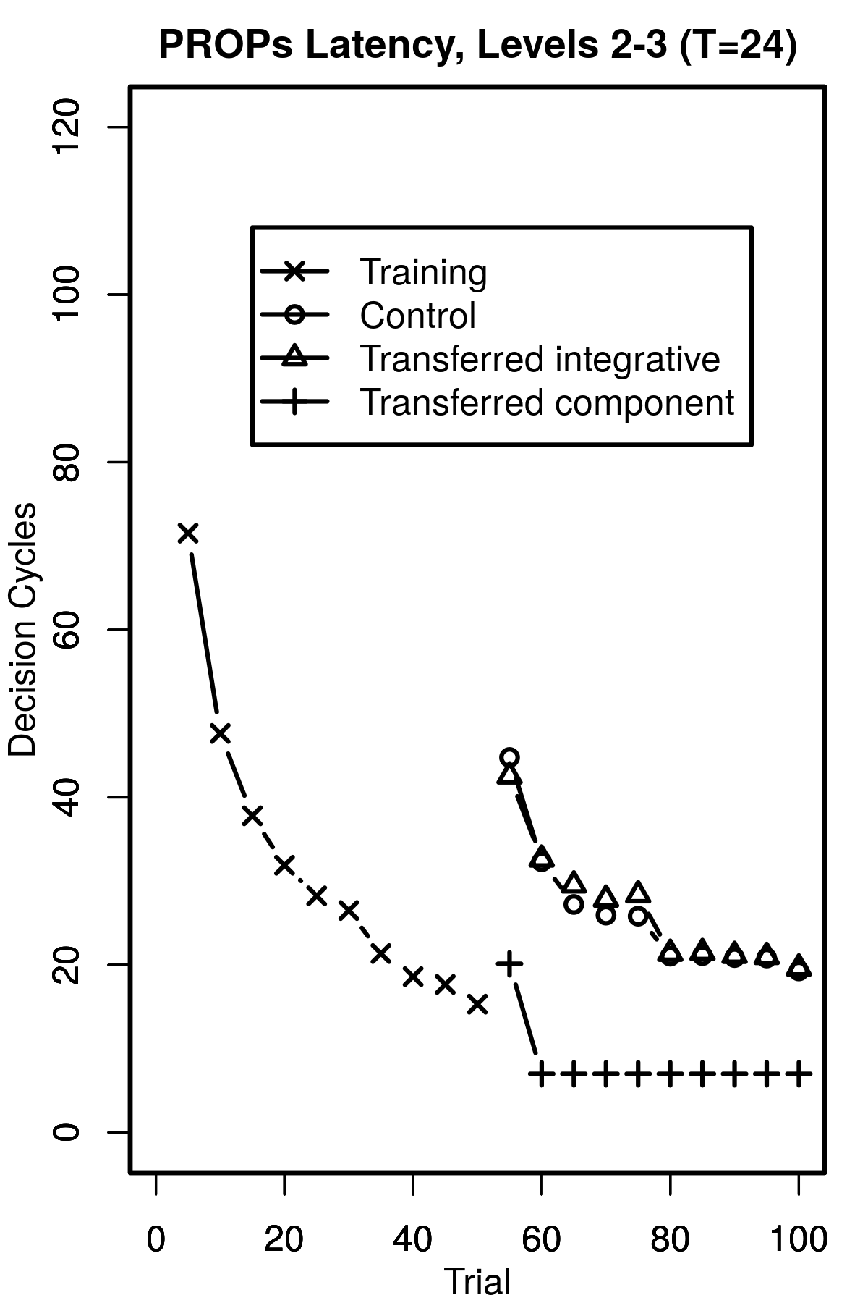
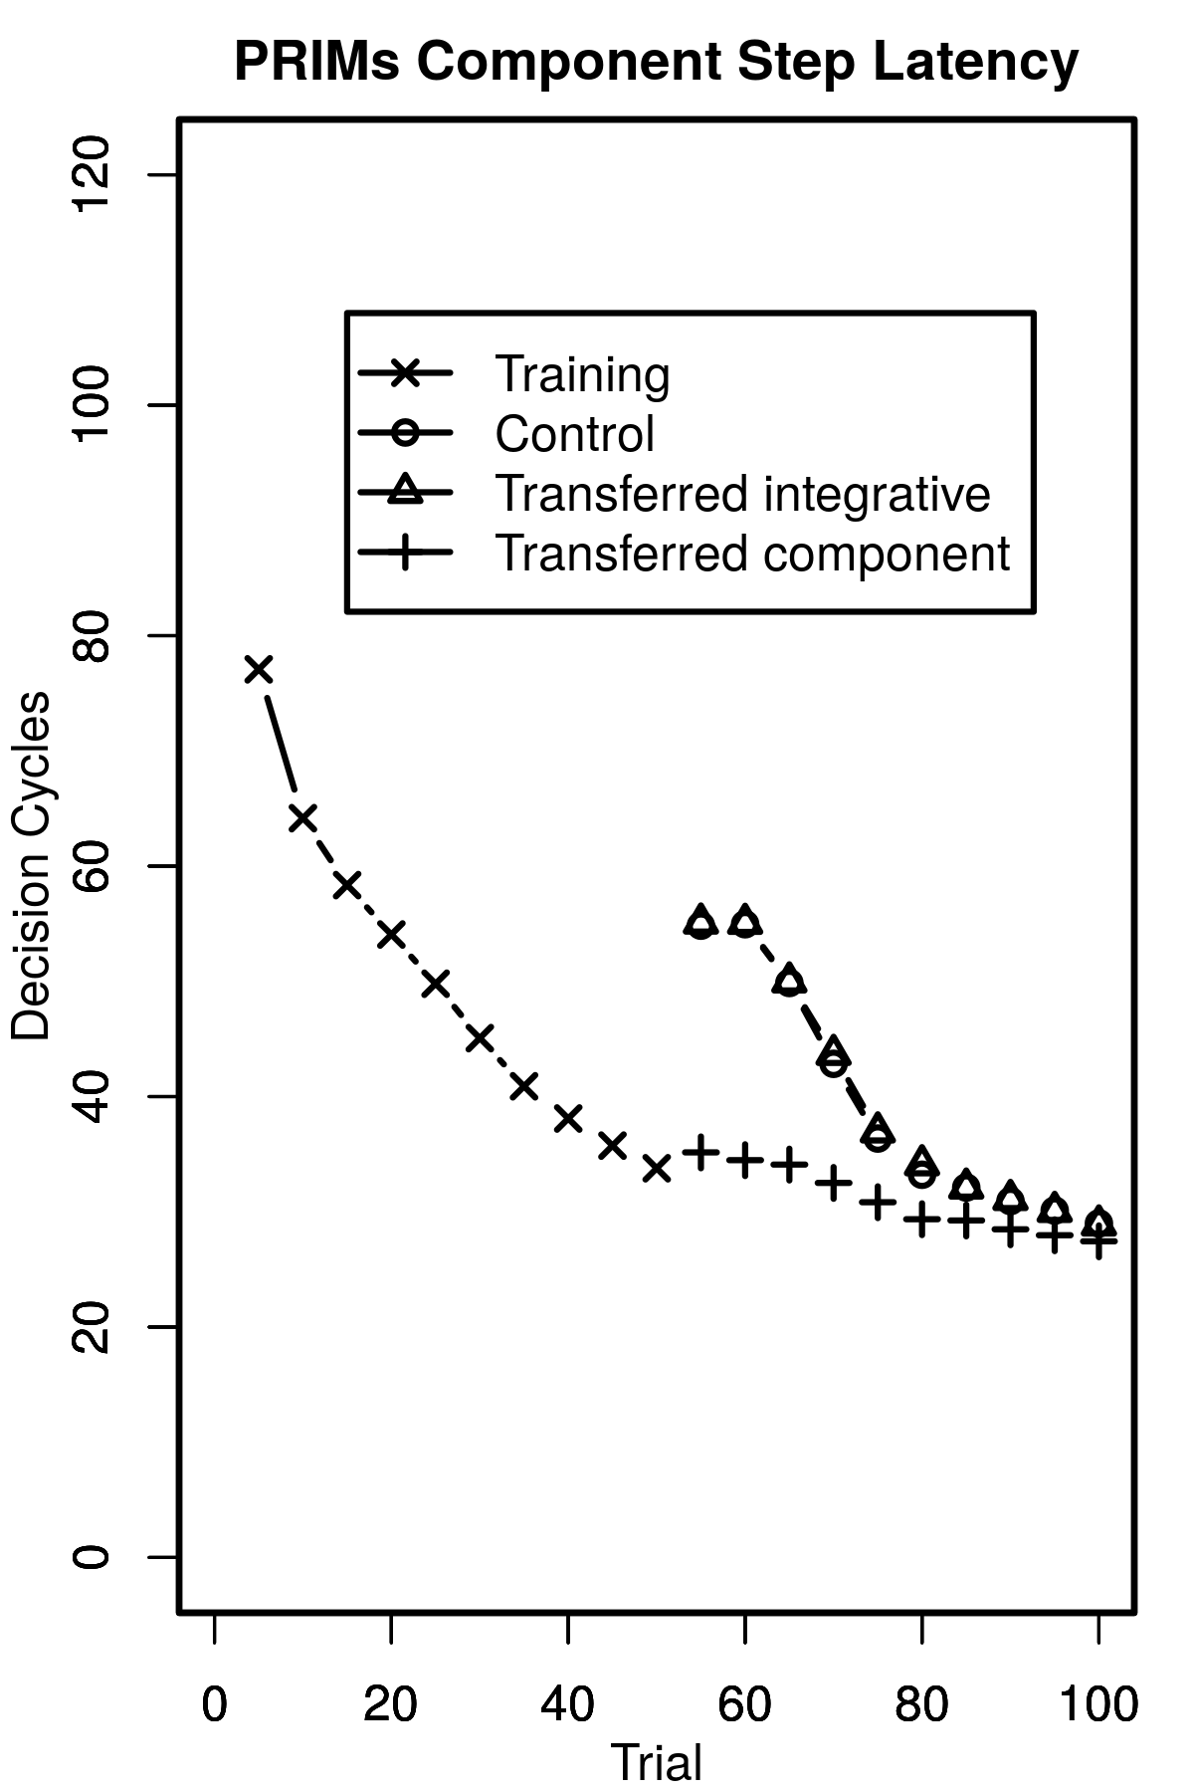
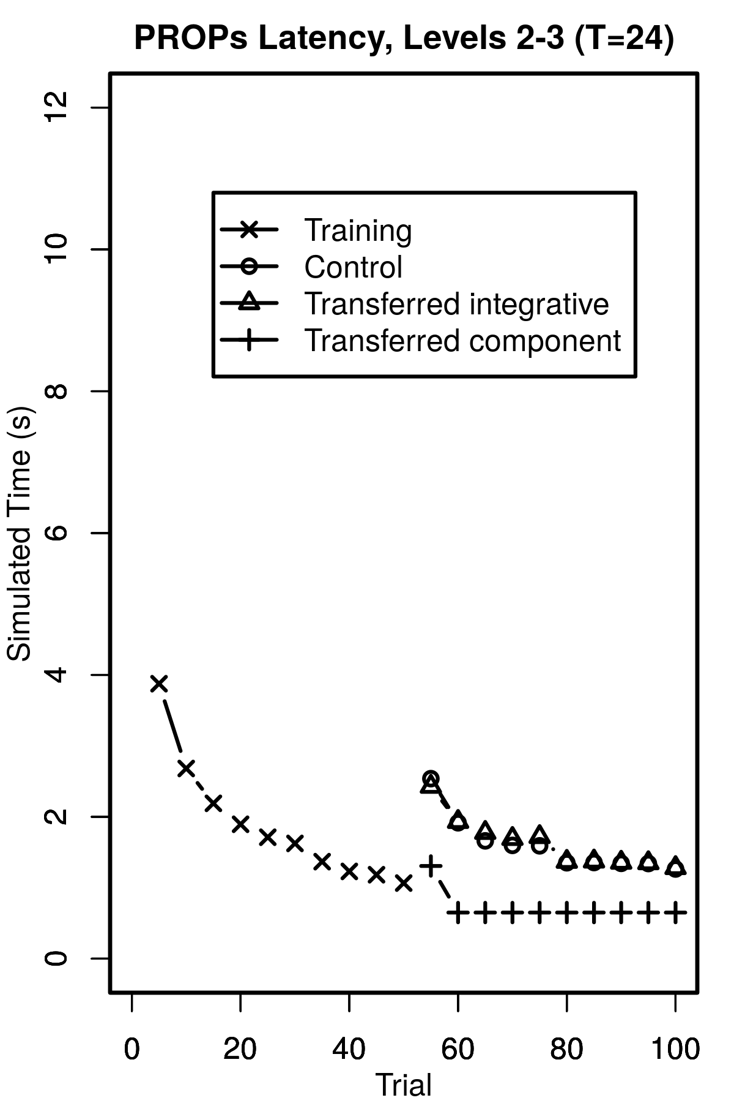
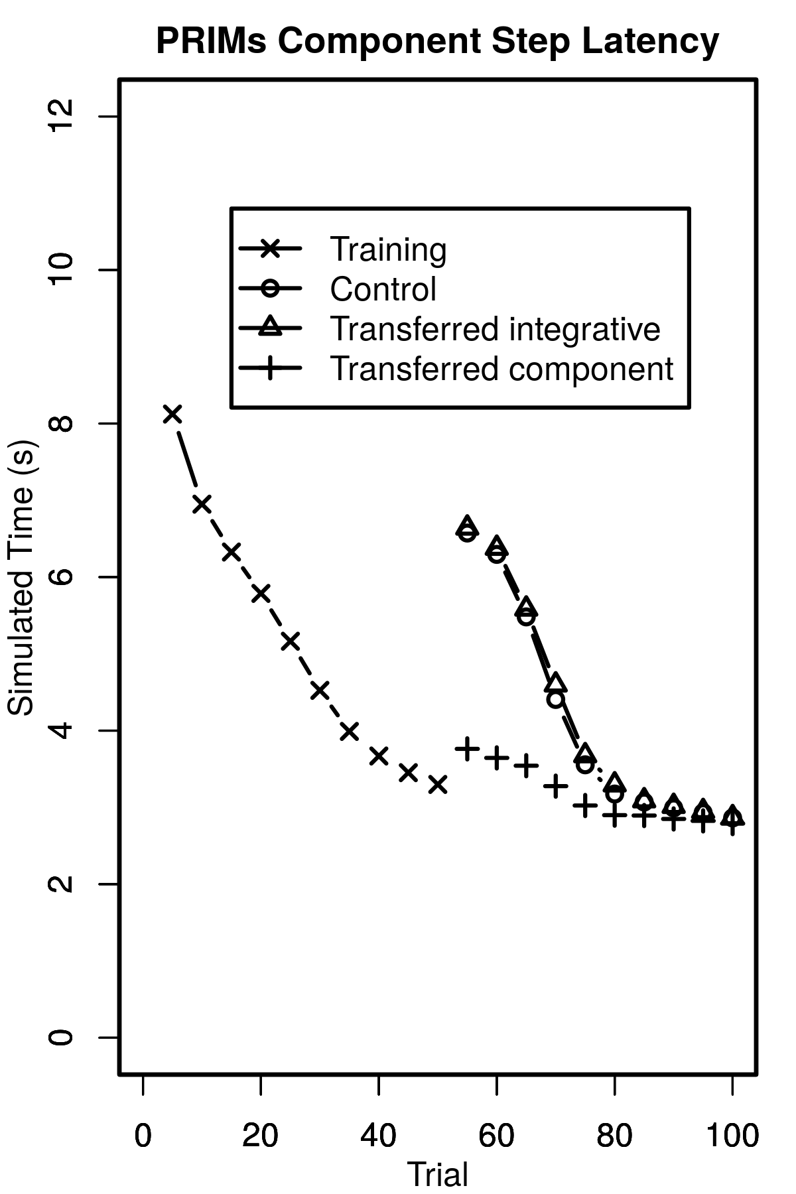
Simulated Time Differences
The same learning results in about the same decision cycle counts in PRIMs or PROPs.
But this results in different simulated times according to the theories.
L 2,3
PRIMs
L 2,3
PRIMs
Decision Cycles
Simulated Time

Slide 40
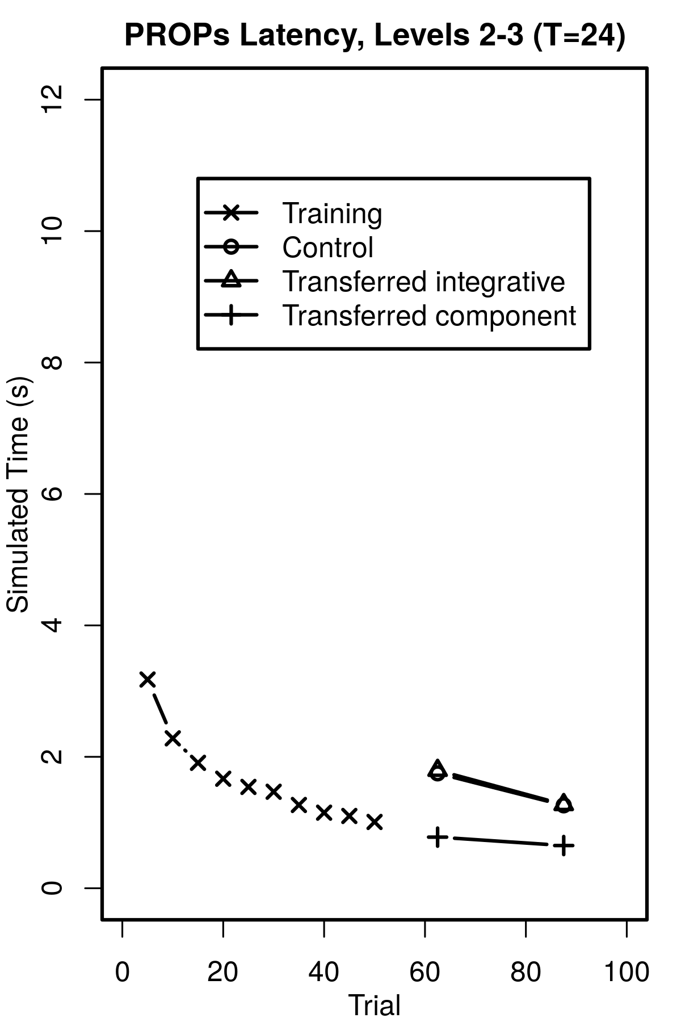
Why doesn’t PRIMs converge?
Both models learn the same instructions.
L3 instruction independence means one decision per learned instruction set.
Same optimum.
Tracing the PRIM agent logic revealed lingering background operations.
Learned away in Soar.
These shift performance up by a constant.
PRIMs
L 2,3

Slide 41
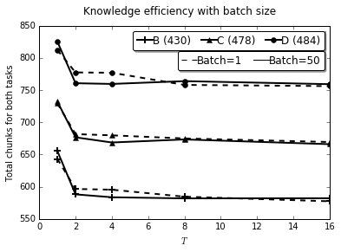
Threshold and Transfer
Alternate training with a test task until fully learned.
Fewer required rules means reuse of rules (transfer).
Two variables:
Threshold T
Task batch size
Ex: 2 (AA BB AA BB) vs 4 (AAAA BBBB)
Tested: 1,2,5,10,25,50
Only batch=1 much different.
Most transfer gains after only T=2.

Slide 42
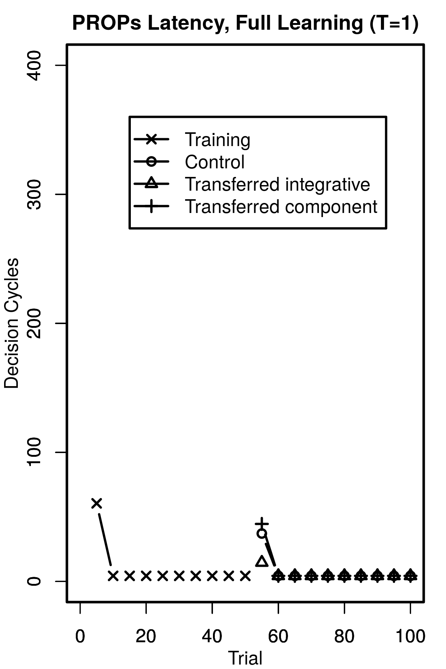
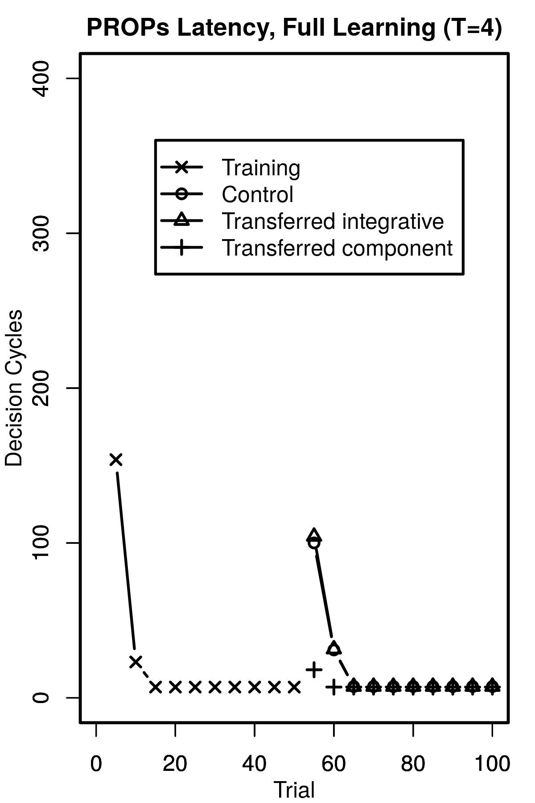
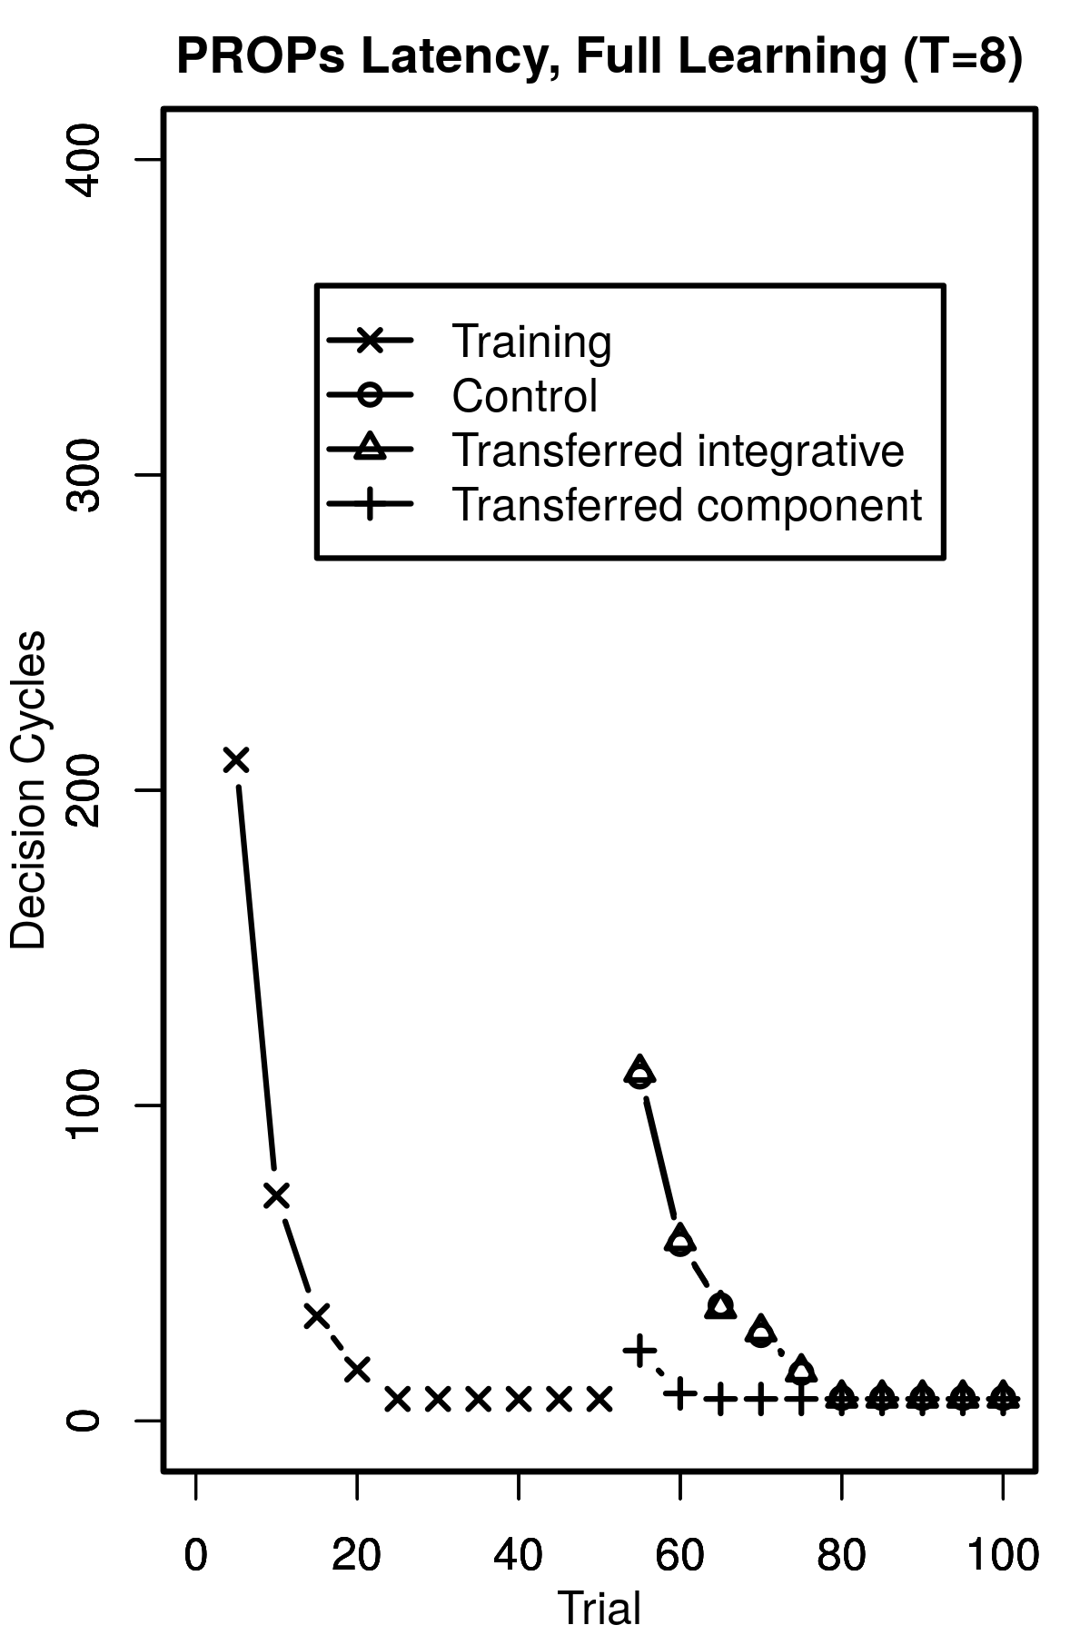
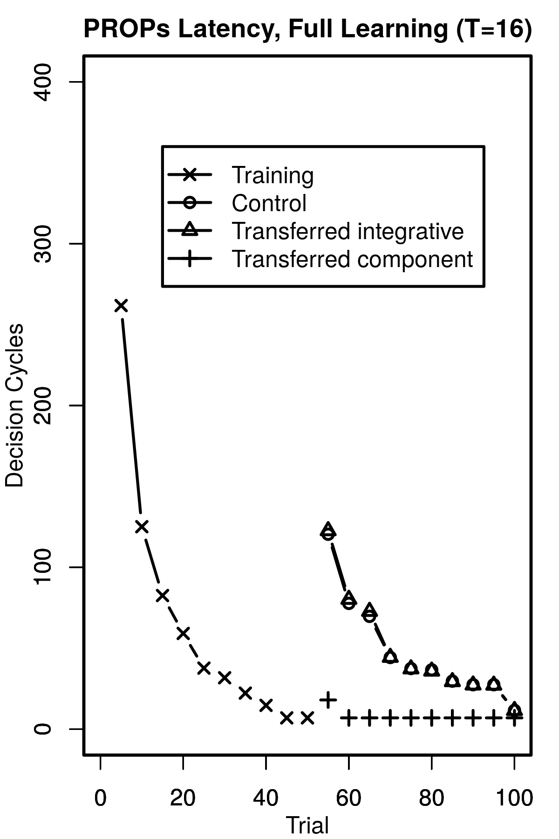
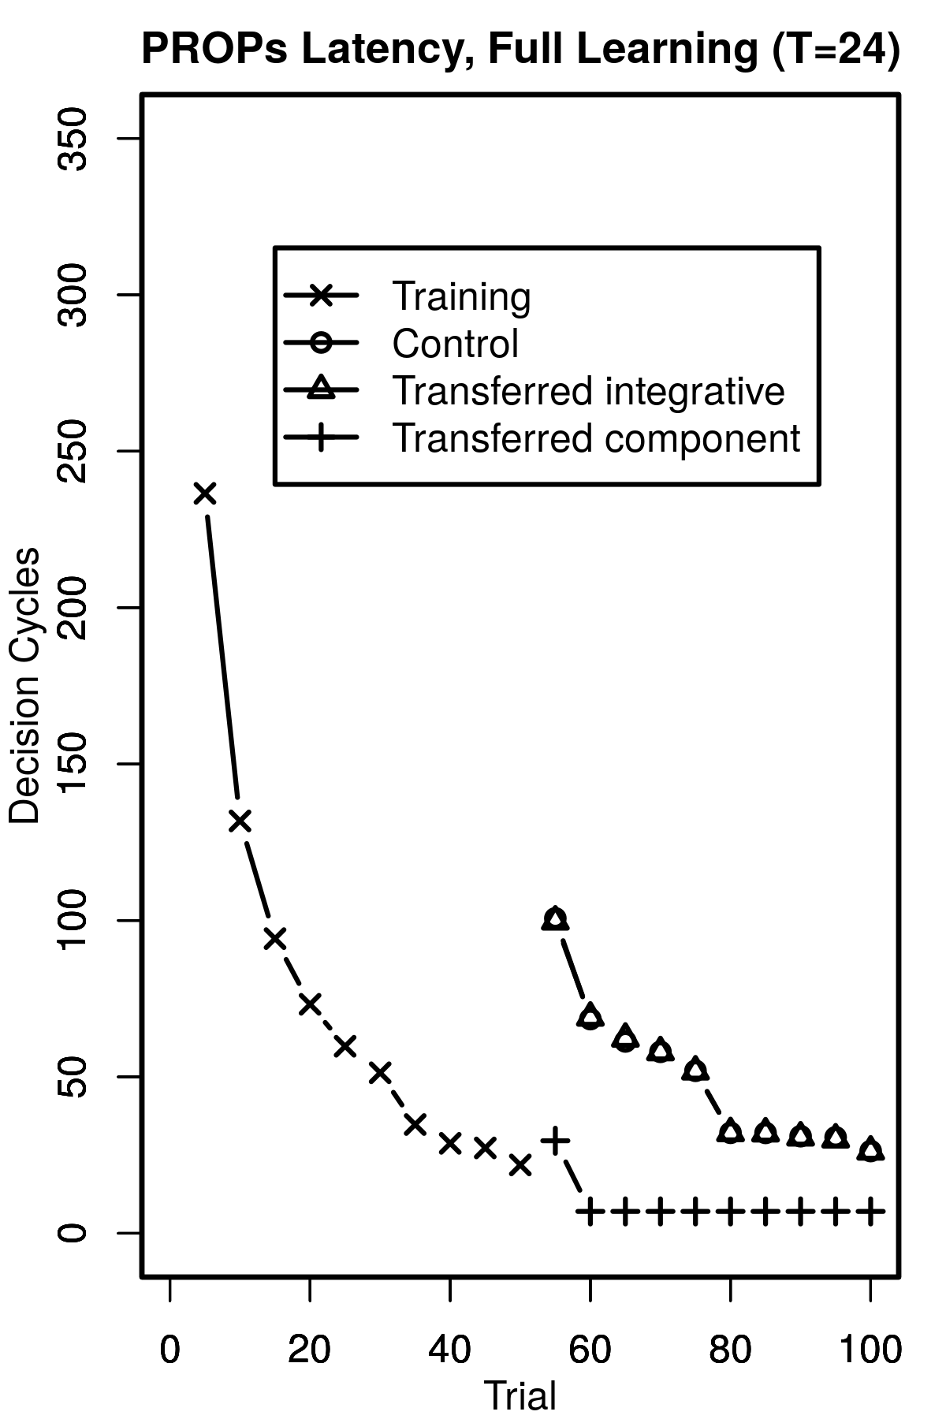
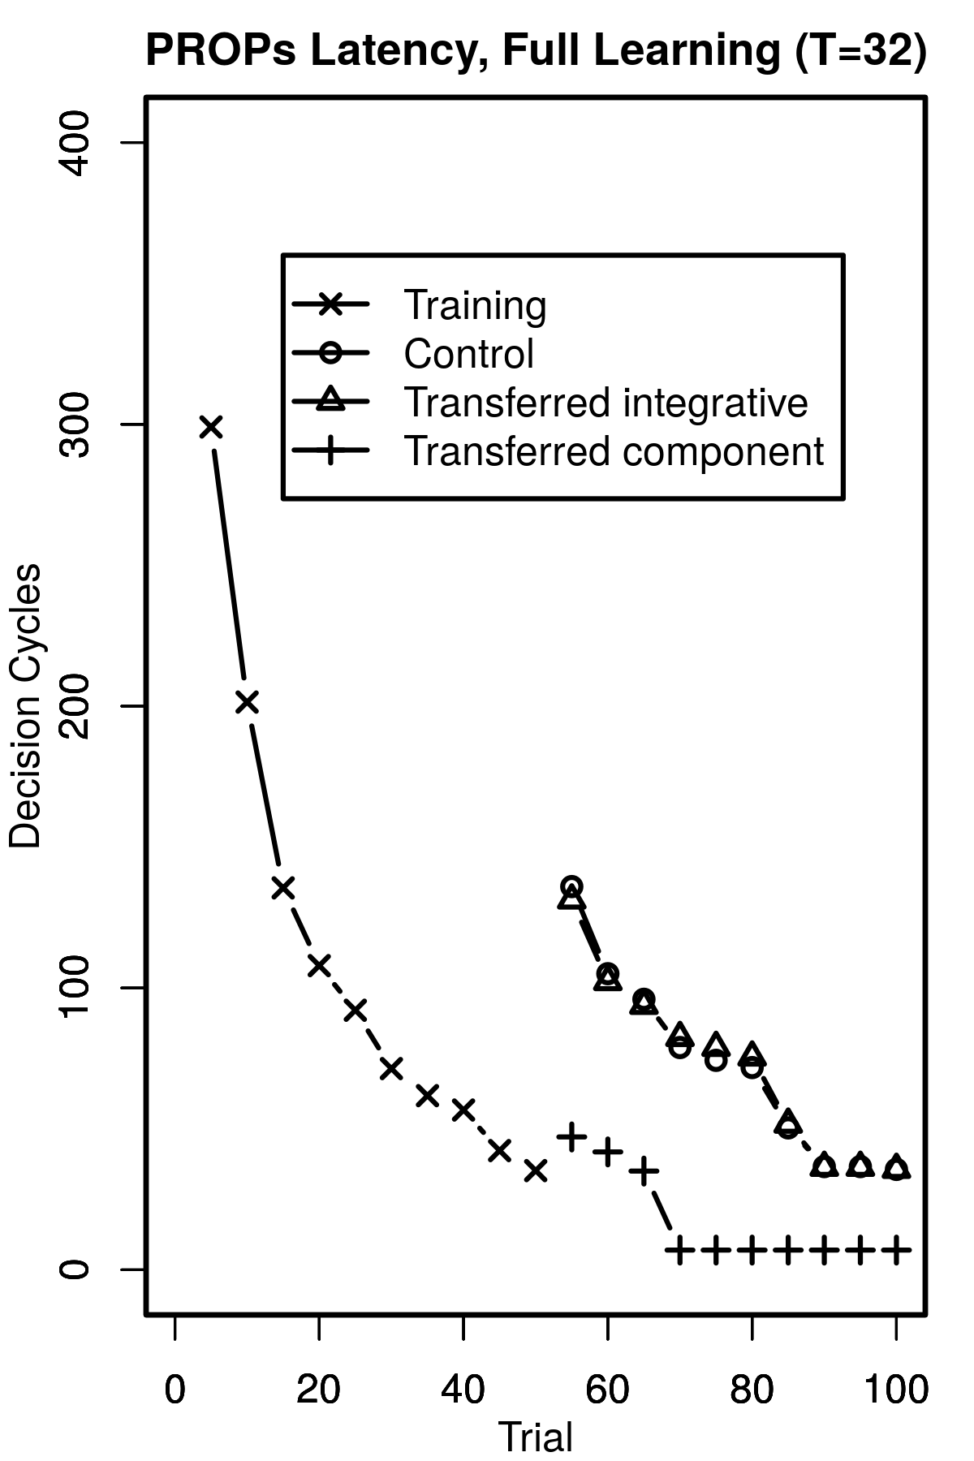
Choice of Primary Threshold
An initial sweep revealed T=24 to match most with human results.
1
4
8
16
24
32
Human
Notes:
More values were tested than shown. Each of the layers of learning too, but only showing one case as an example.

Slide 43
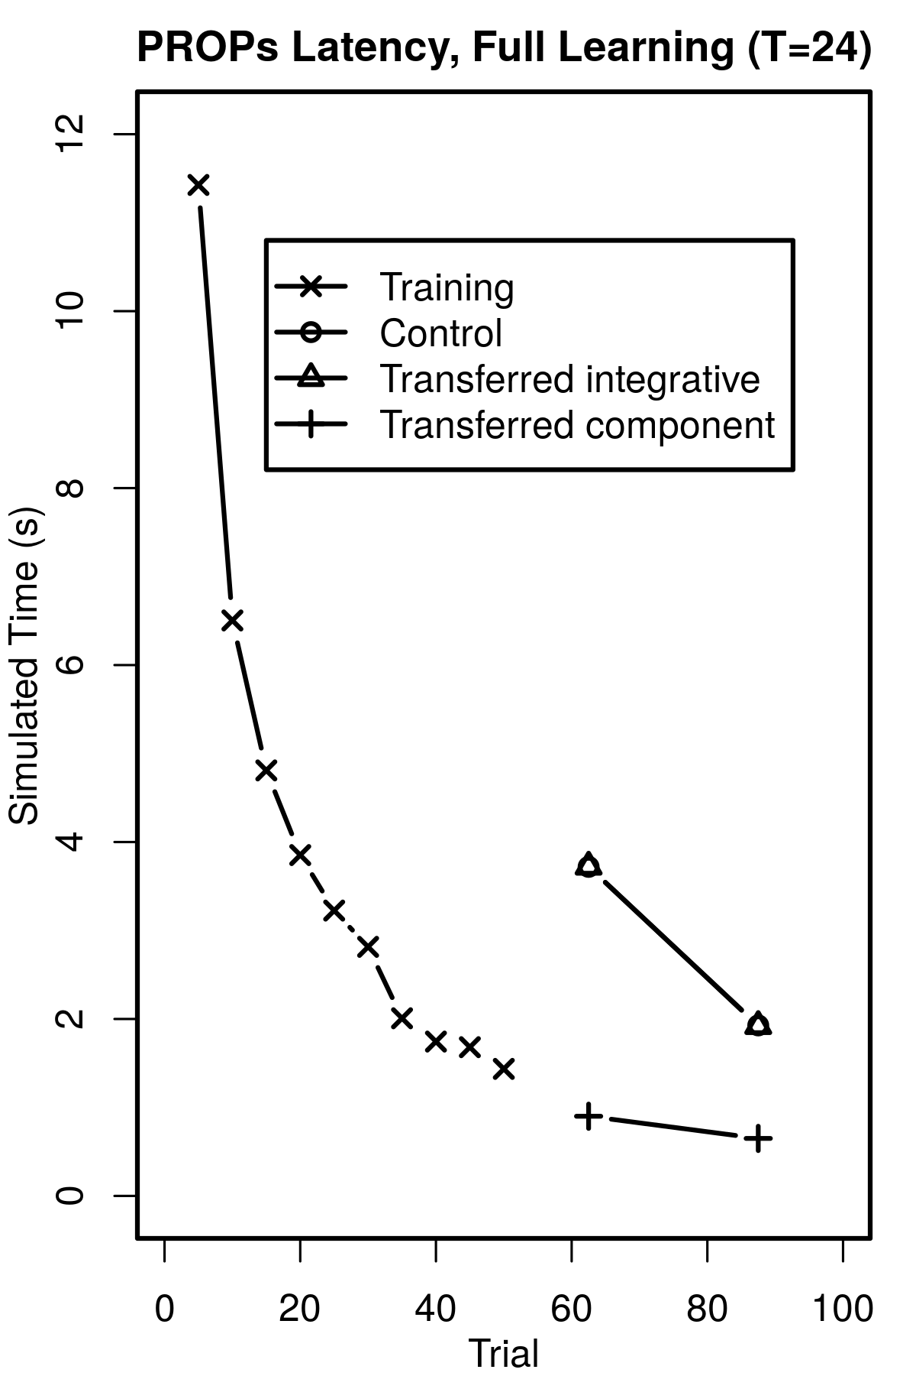
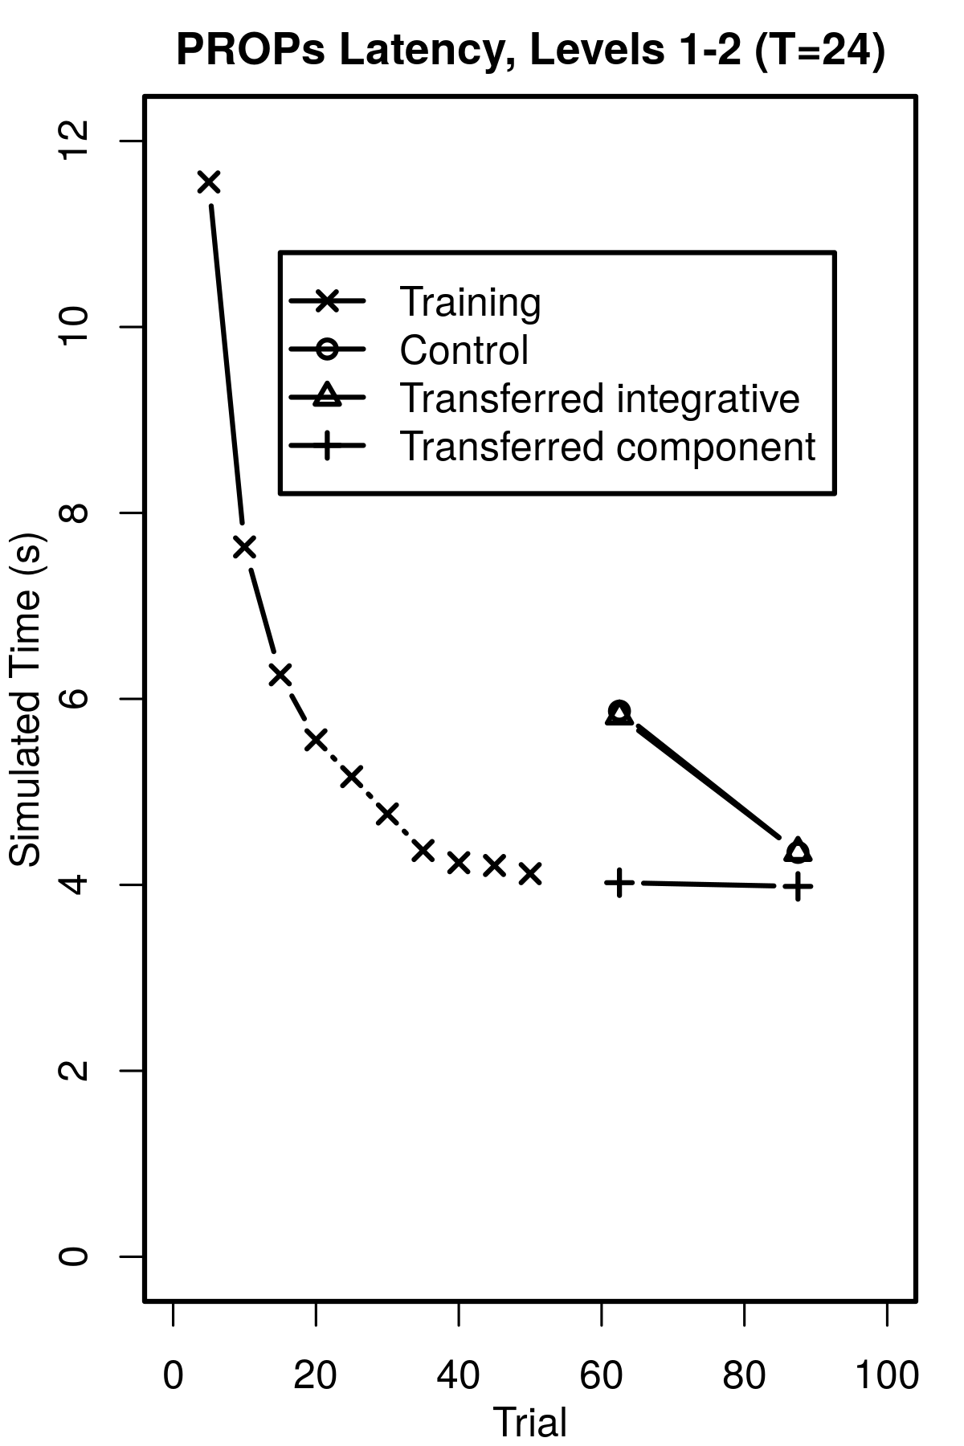
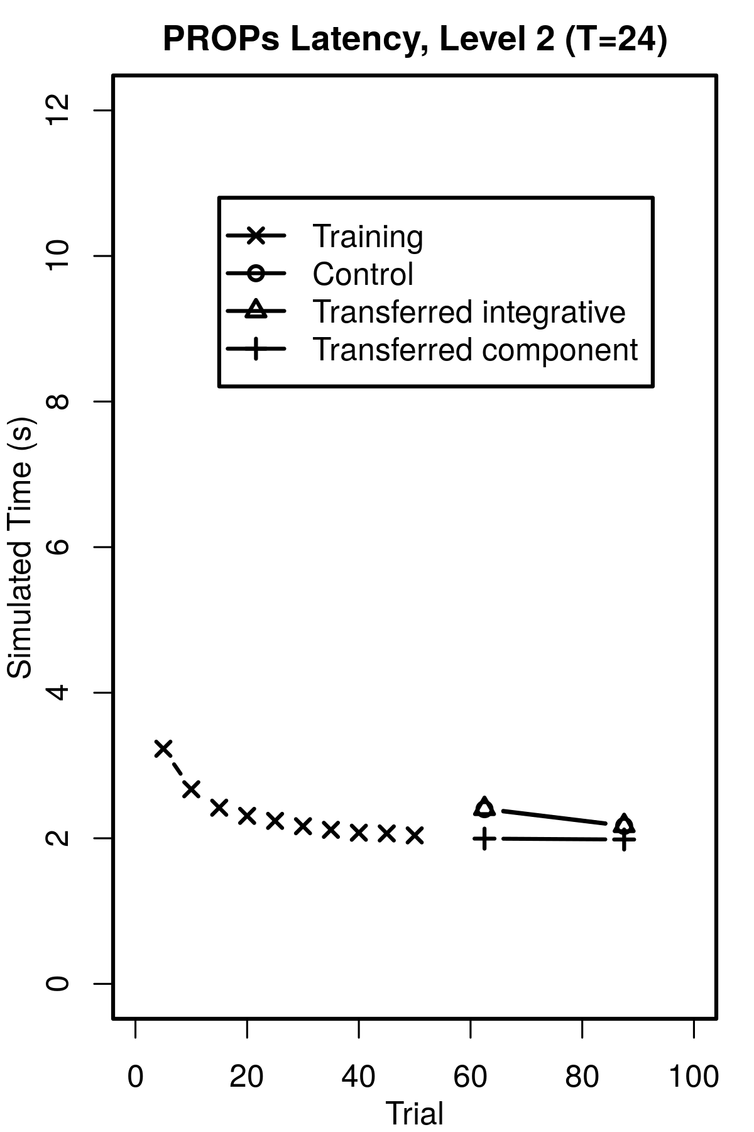
Component step performance
L 1,2,3
L 1,2
Averages
Simulated Time
Human
PRIMs
L 2,3
L 2

Slide 44
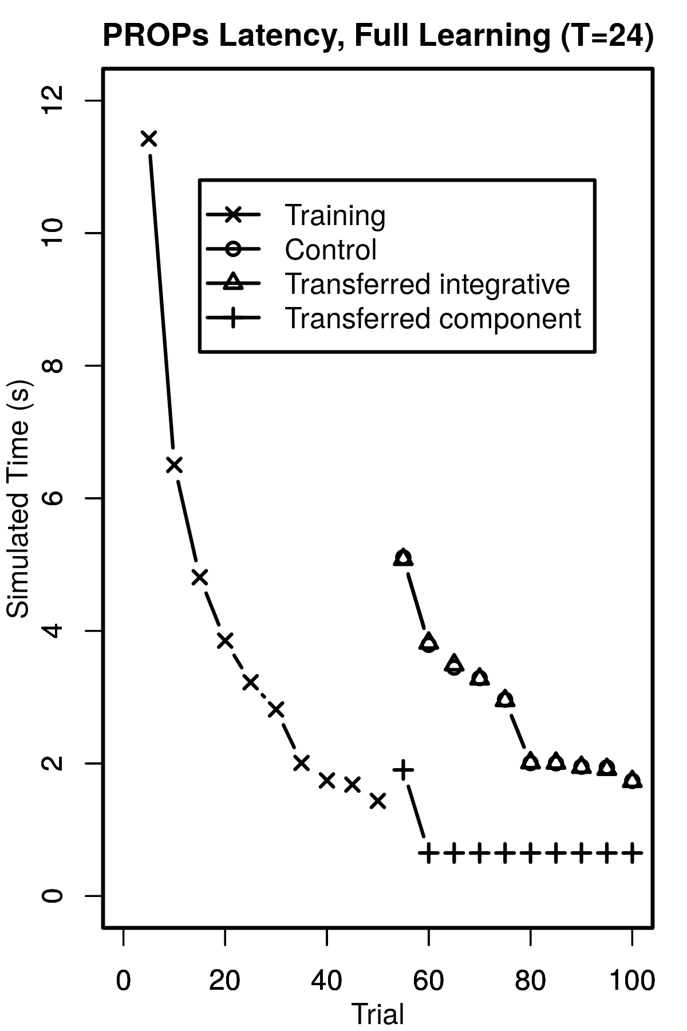
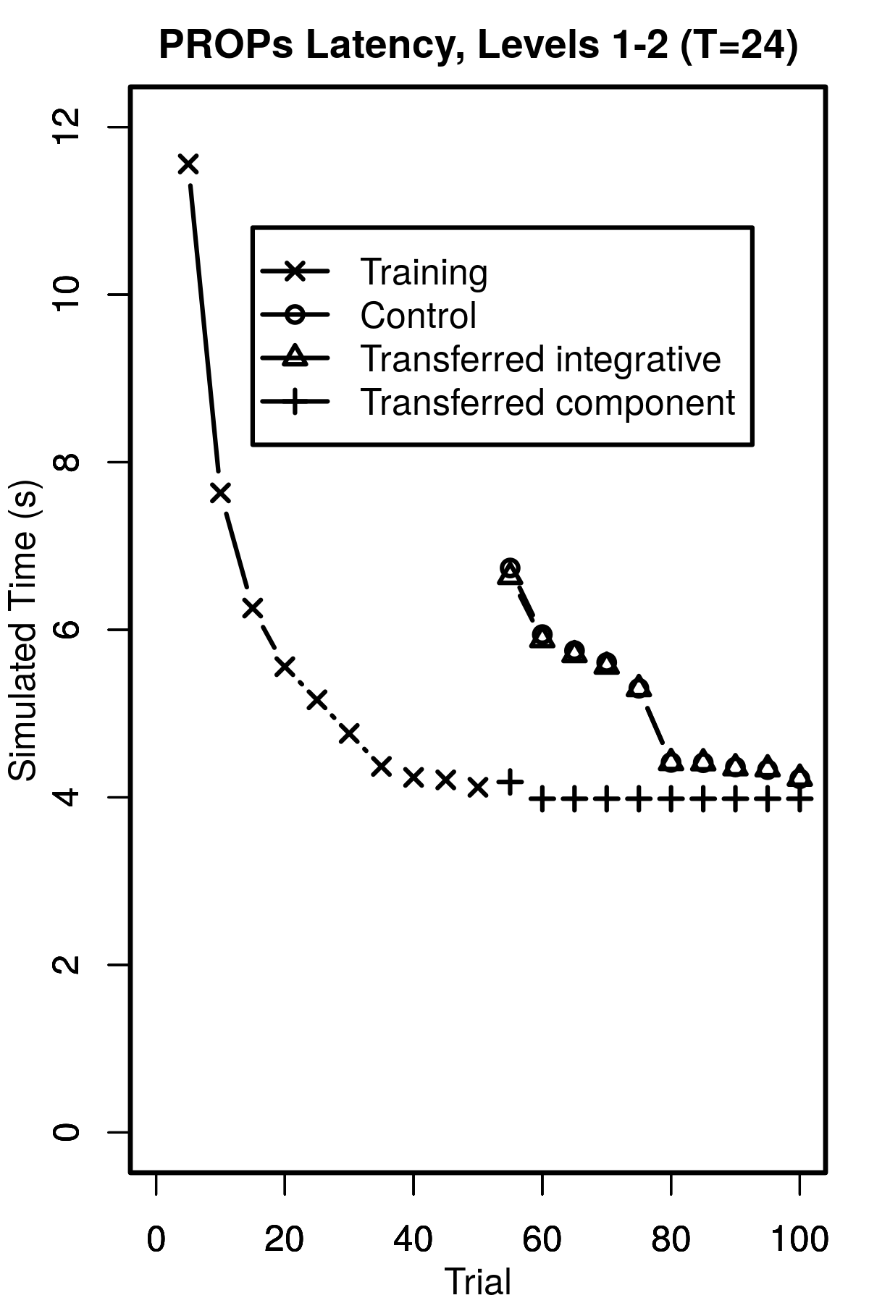
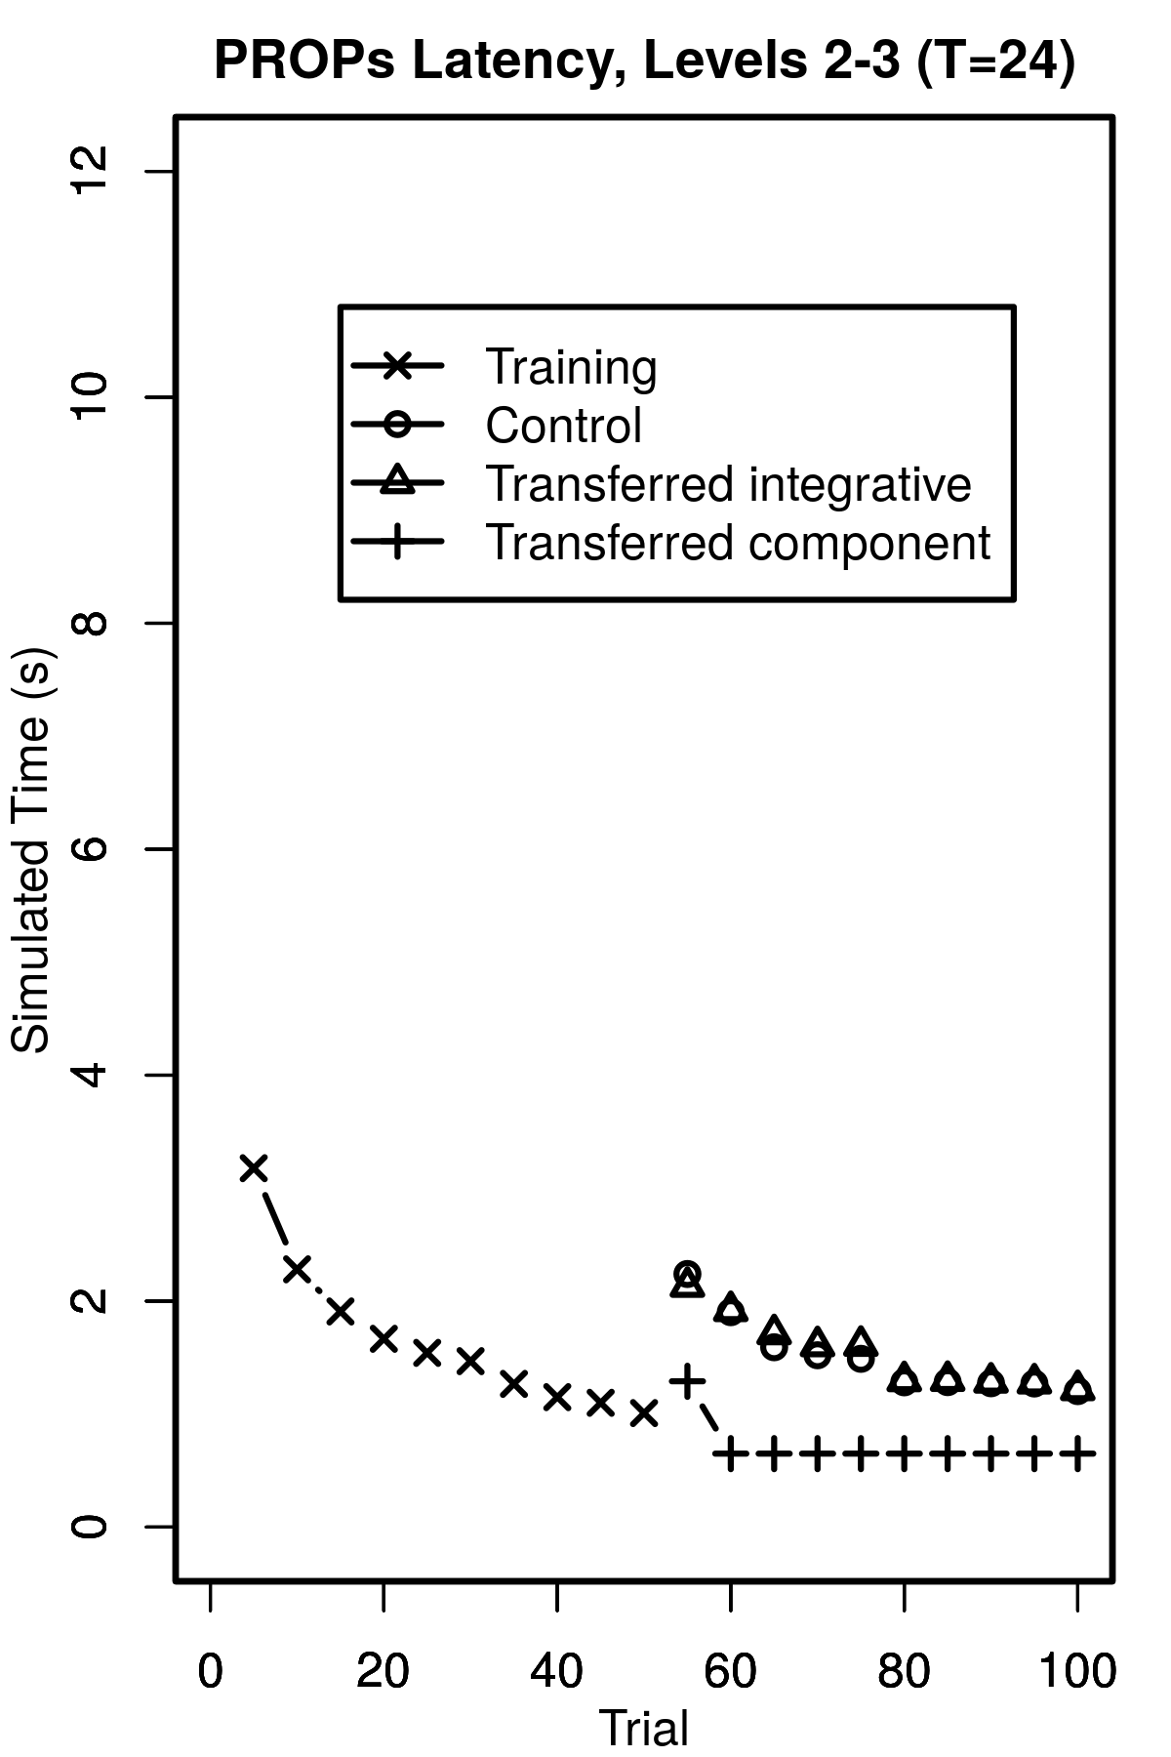
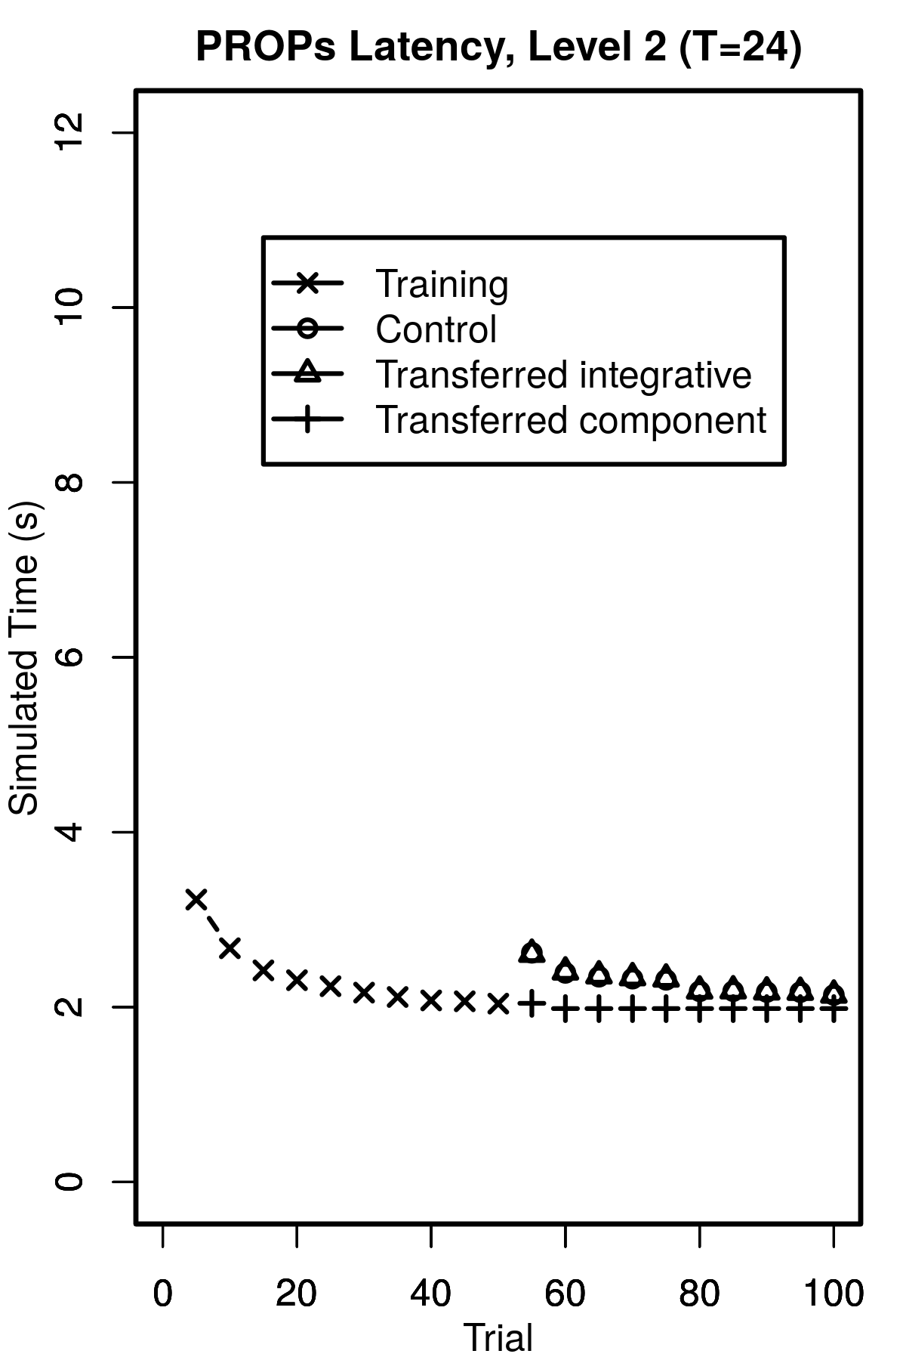
Component step performance
L 1,2,3
L 1,2
Details
Simulated Time
Human
PRIMs
L 2,3
L 2

Slide 45
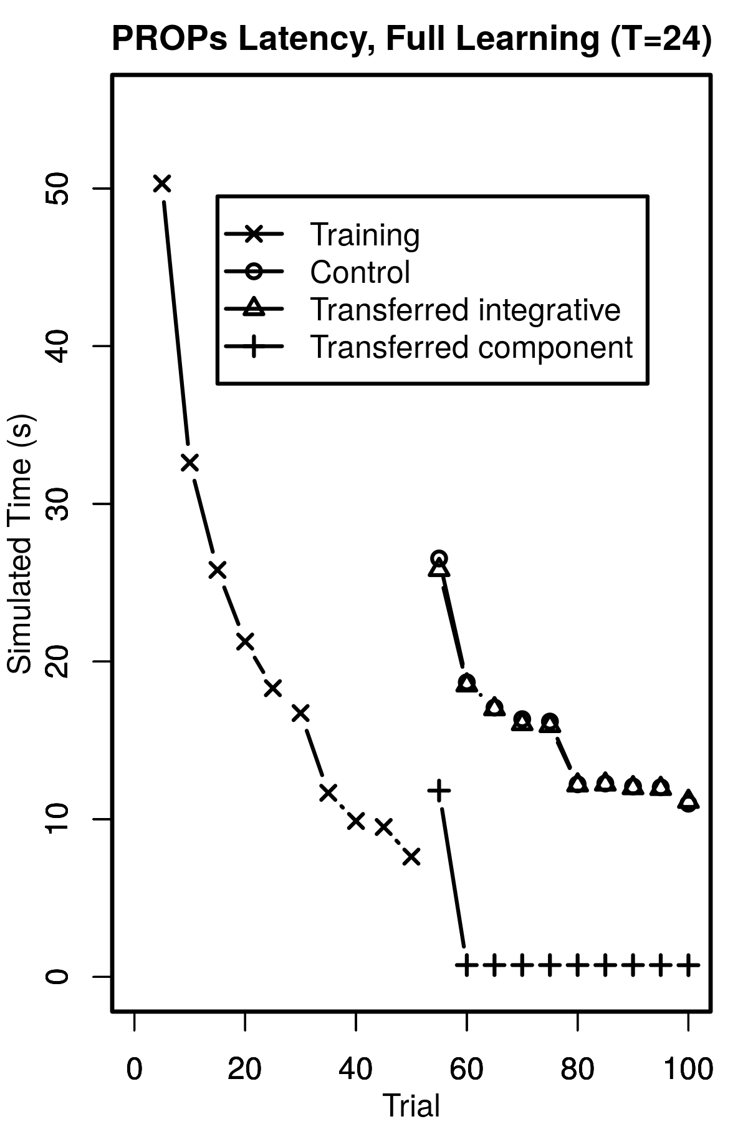
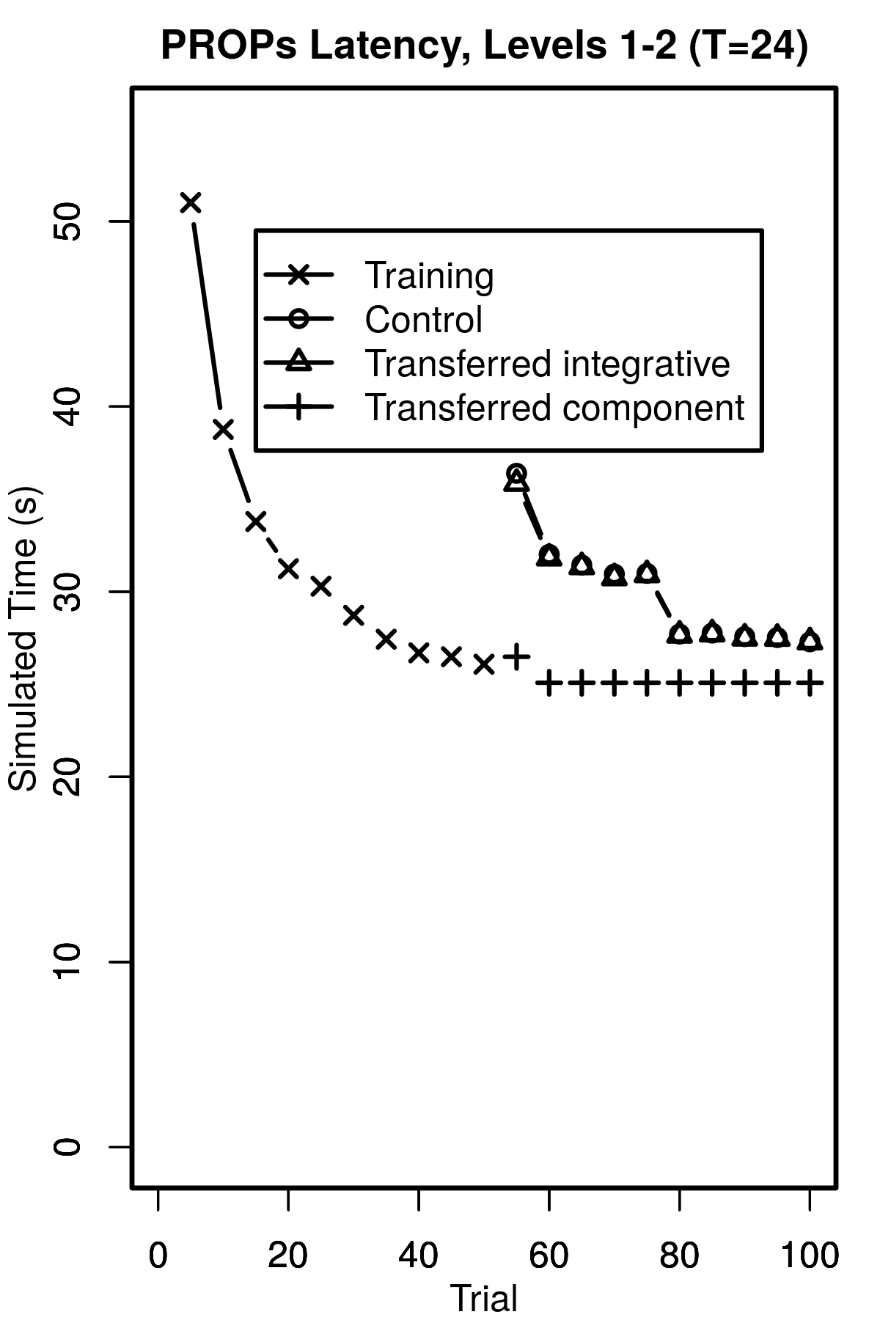
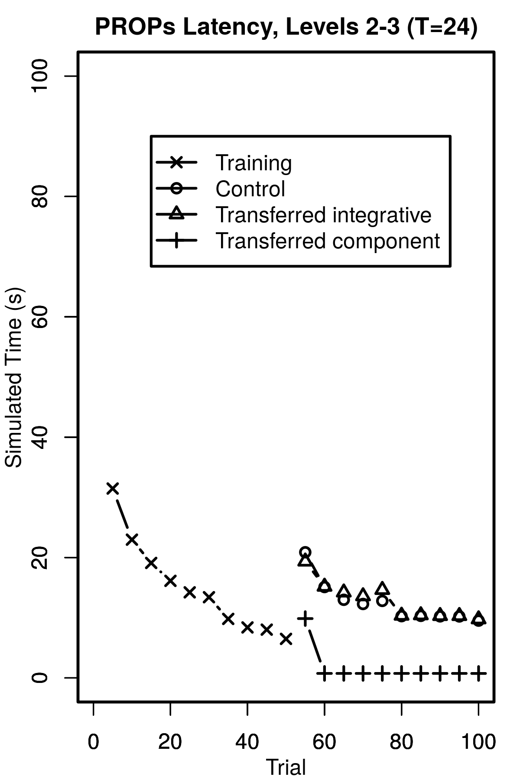
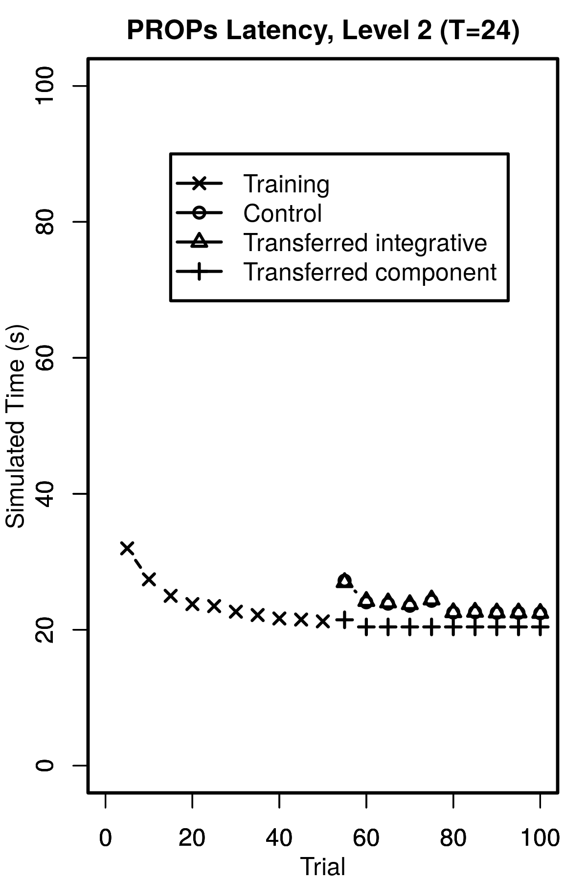
Component step performance
L 1,2,3
L 1,2
Details
Simulated Time
With Overheads
Human
PRIMs
L 2,3
L 2

Slide 46
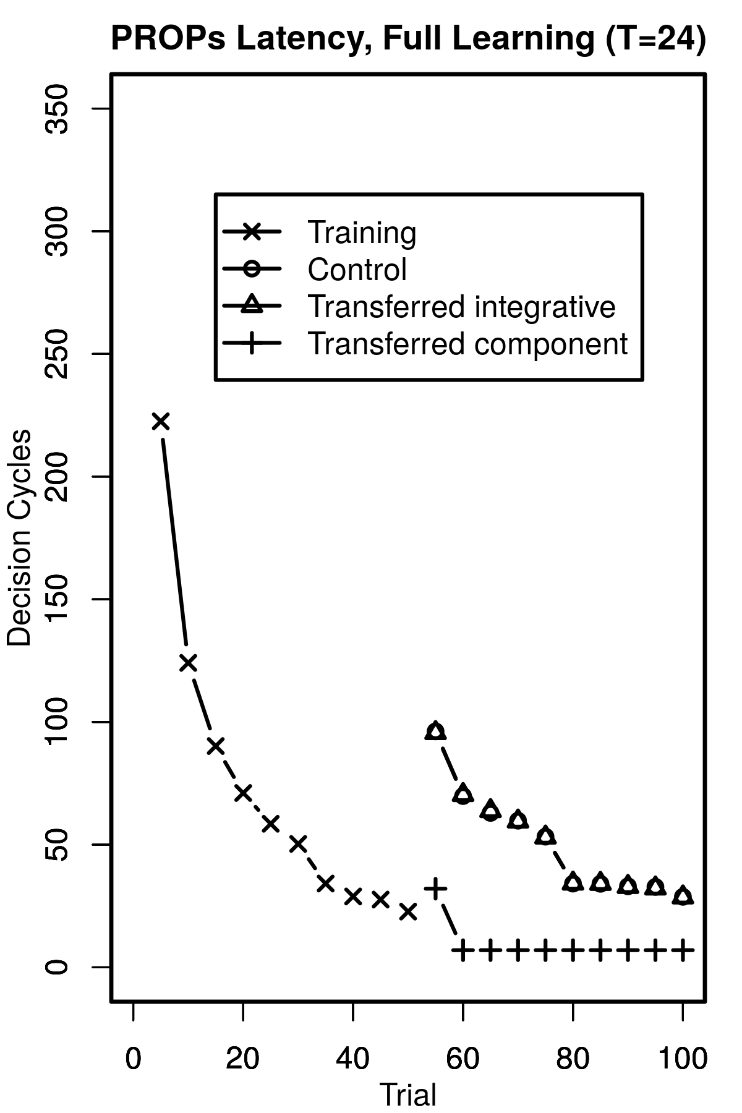
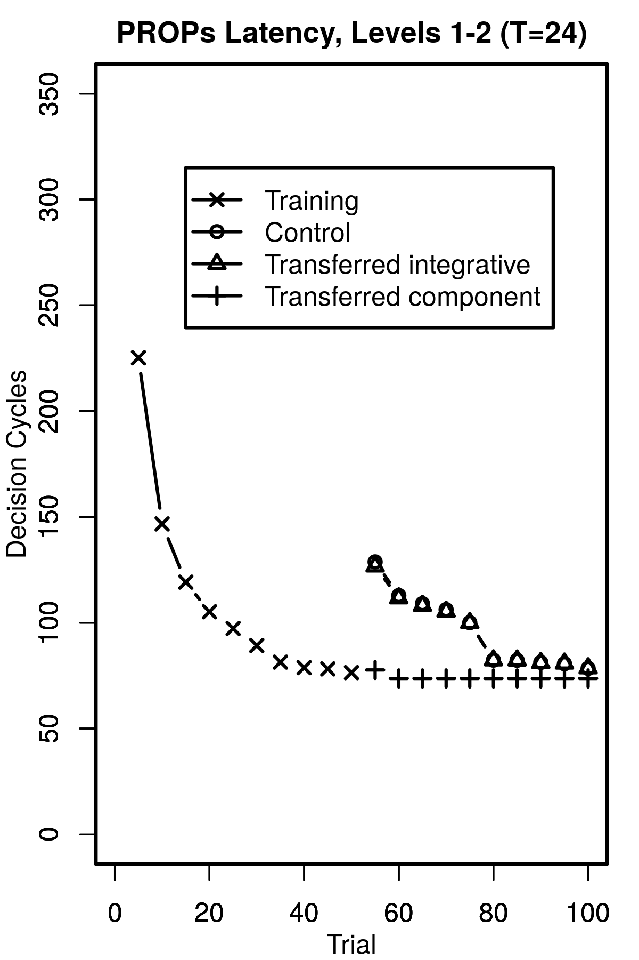
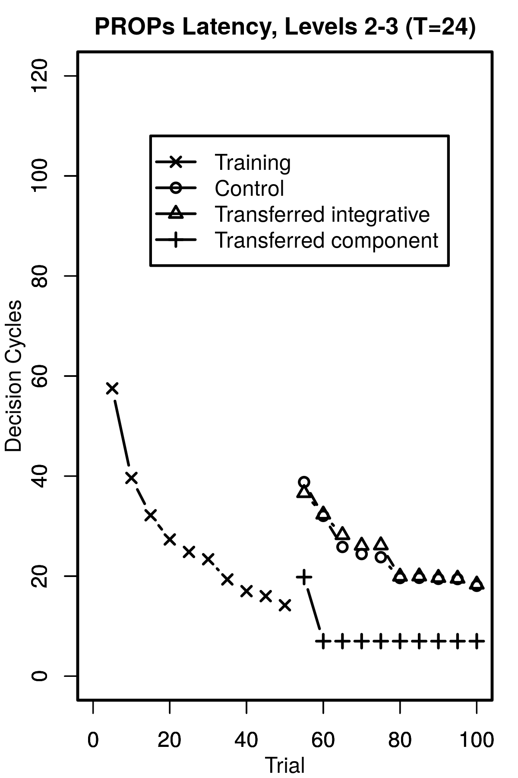
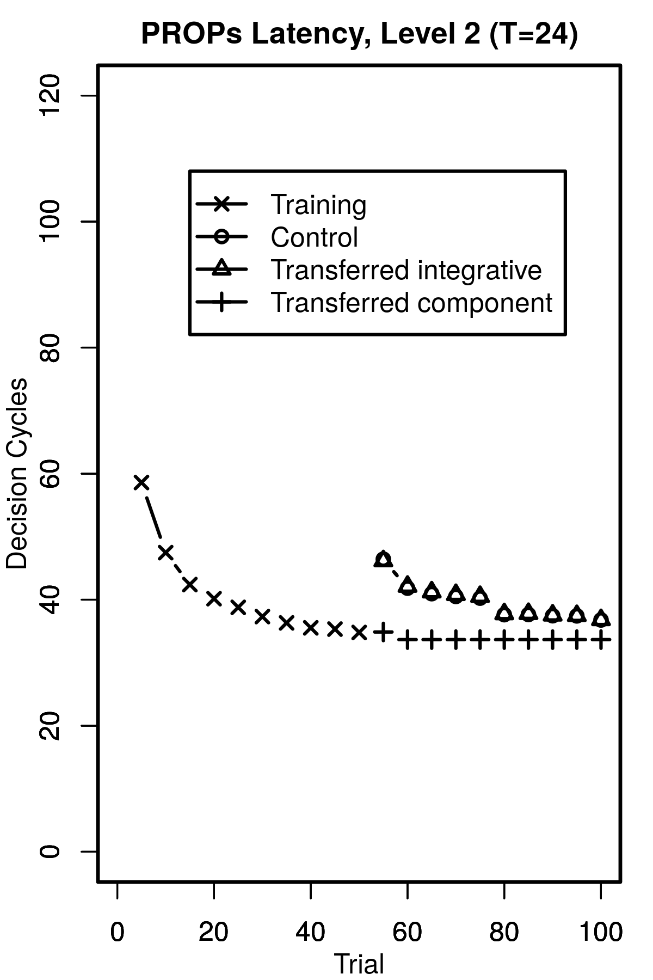
Component step performance
L 1,2,3
L 1,2
Details
Decision Cycles
Human
PRIMs
L 2,3
L 2

Slide 47
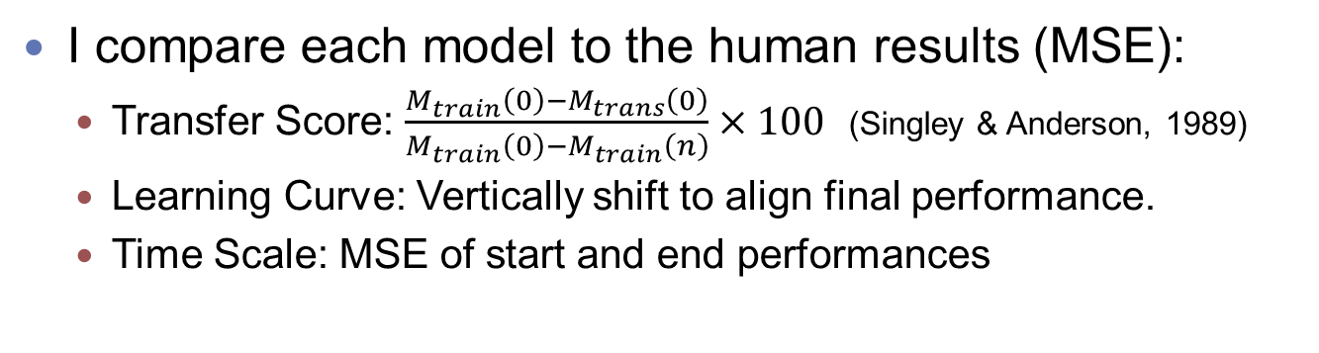
Quantitative comparison
I compare each model to the human results (MSE):
Transfer Score: $\frac{M_{train}\left(0\right)−M_{trans}\left(0\right)}{M_{train}\left(0\right)−M_{train}\left(n\right)}×100$ (Singley & Anderson, 1989)
Learning Curve: Vertically shift to align final performance.
Time Scale: MSE of start and end performances
MSE | PRIM | PROP 1,2,3 | PROP 2,3 | PROP 2 | PROP 1,2
Transfer | 203.39 | 270.68 | 355.23 | 207.46 | 201.50
Shifted Curve | 1.37 | 1.02 | 4.17 | 6.04 | 0.04
Scale | 4.83 | 1.61 | 34.87 | 32.69 | 0.46
Shifted Scale | 5.08 | 1.96 | 17.08 | 23.28 | 0.16

